Slide 1
Bell Labs Role in Programming Languages and Algorithms
Al Aho
aho@cs.columbia.edu
Simons Foundation
May 6, 2015

Slide 3
What is an Algorithm?
A finite sequence of instructions, each of which has a clear meaning and can be performed with a finite amount of effort in a finite length of time.
Alfred V. Aho, John E. Hopcroft, and Jeffrey D. Ullman
Data Structures and Algorithms
Addison Wesley, 1983

Slide 4
Models of Computation
Underlying every algorithm is a model of computation
Important models of computation
Turing machines
The lambda calculus
Random access machines
Circuits with Boolean gates
Circuits with quantum gates

Slide 5
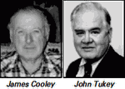
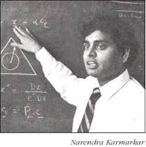
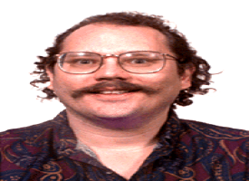
Landmark Algorithms from Bell Labs
Cooley-Tukey: Fast Fourier Transform (1965)
Peter Shor
Karmarkar: Interior-Point Linear Programming (1984)
Shor: Factoring Integers on a Quantum Computer (1994)

Slide 6
Shor’s Integer Factorization Algorithm
Problem: Given a composite n-bit integer, find a nontrivial factor.
Best-known deterministic algorithm on a classical computer has time complexity exp(O( n^{1/3} log^{2/3} n )).
A quantum computer can solve this problem in O( n³ ) operations.
Peter Shor
Algorithms for Quantum Computation: Discrete Logarithms and Factoring
Proc. 35th Annual Symposium on Foundations of Computer Science, 1994, pp. 124-134

Slide 7
Integer Factorization: Estimated Times
Classical: number field sieve
Time complexity: exp(O(n^{1/3} log^{2/3} n))
Time for 512-bit number: 8400 MIPS years
Time for 1024-bit number: 1.6 billion times longer
Quantum: Shor’s algorithm
Time complexity: O(n³)
Time for 512-bit number: 3.5 hours
Time for 1024-bit number: 31 hours
(assuming a 1 GHz quantum device)
M. Oskin, F. Chong, I. Chuang
A Practical Architecture for Reliable Quantum Computers
IEEE Computer, 2002, pp. 79-87

Slide 8
Shor’s Quantum Factoring Algorithm
Input: A composite number N
Output: A nontrivial factor of N
if N is even then return 2;
if N = a^{b} for integers a >= 1, b >= 2 then
return a;
x := rand(1,N-1);
if gcd(x,N) > 1 then return gcd(x,N);
r := order(x mod N); // only quantum step
if r is even and x^{r/2} != (-1) mod N then
{f1 := gcd(x^{r/2}-1,N); f2 := gcd(x^{r/2}+1,N)};
if f1 is a nontrivial factor then return f1;
else if f2 is a nontrivial factor then return f2;
else return fail;
Nielsen and Chuang, 2000

Slide 9
The Order-Finding Problem
Given positive integers x and N, x < N, such that gcd(x, N) = 1, the order of x (mod N) is the smallest integer r such that x ^{r} ≡ 1 (mod N).
E.g., the order of 5 (mod 21) is 6.
The order-finding problem is, given two relatively prime integers x and N, to find the order of x (mod N).
All known classical algorithms for order finding are superpolynomial in the number of bits in N.

Slide 10
Quantum Order Finding
Order finding for an integer N can be done with a quantum circuit containing
O((log N)² log log (N) log log log (N))
elementary quantum gates.
Best known classical algorithm requires
exp(O((log N)^{1/3} (log log N)^{2/3} ))
time on a classical computer.

Slide 11
Some Other Notable Bell Labs Algorithms
Aho-Corasick: multiple keyword string matching
Foschini: V-BLAST MIMO signal detection
Garey, Graham, Johnson: approximation algorithms
Grover: quantum search
Hamming: error detecting and correcting codes
Johnson: shortest paths
Kernighan-Lin: graph partitioning heuristic
Kruskal: spanning tree
Lin-Kernighan: traveling salesman heuristic
Prim: spanning tree
Sethi-Ullman: optimal code generation
Thompson: regular expression matching

Slide 12
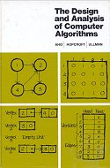
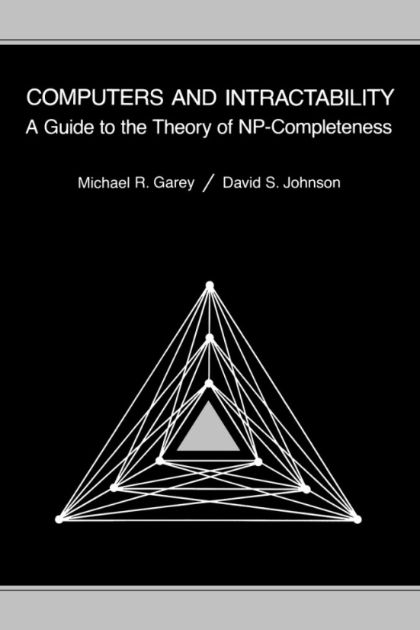
Bell Labs Wrote Many of the Early Influential Books on Algorithms
Aho, Hopcroft and Ullman (1974)
Techniques for designing efficient algorithms
Garey and Johnson (1979)
A guide to NP-complete problems

Slide 13
What is a Programming Language?
A notation for describing algorithms to computers and people

Slide 14
Programming Languages and Algorithms
Programming Languages + Algorithms =
Software

Slide 15
Credit: Intel Corporation
Notes:
15

Slide 16
Software in Our World Today
How much software does the world use today?
Guesstimate: over one trillion lines of source code
What is the sunk cost of the legacy base?
$100 per line of finished, tested source code
How many bugs are there in the legacy base?
10 to 10,000 defects per million lines of source code
A. V. Aho
Software and the Future of Programming Languages
Science, February 27, 2004, pp. 1131-1133

Slide 17
Early Programming Languages from Bell Labs
L1 and L2 (Bell 1 and Bell 2) for scientific computation on the IBM 650 (V. Wolontis and D. Leagus, 1956)
Macro extensions of compiler languages (M. D. McIlroy and D. E. Eastwood, 1959)
SNOBOL string oriented symbolic language (D. Farber, R. Griswold, and I. Polonsky, 1964)
L for list processing (K. C. Knowlton, 1966)
ALTRAN for computer algebra (W. Brown, 1968)

Slide 18
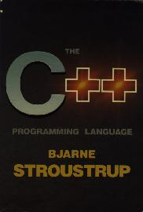
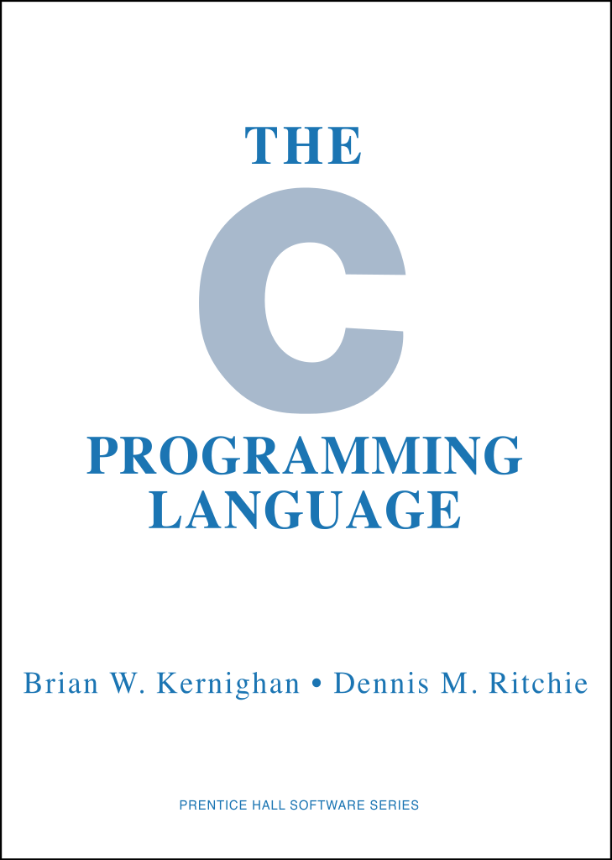
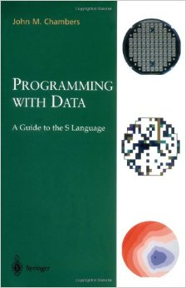
Landmark Programming Languages from Bell Labs
C++ (1979-83)
Bjarne Stroustrup
“When I joined I was basically told to ‘do something interesting’ … ”
C (1969-73)
Dennis Ritchie
“C is quirky, flawed, and an enormous success.”
S (1976-)
John Chambers
“We were concerned to support serious data analysis… ”

Slide 19
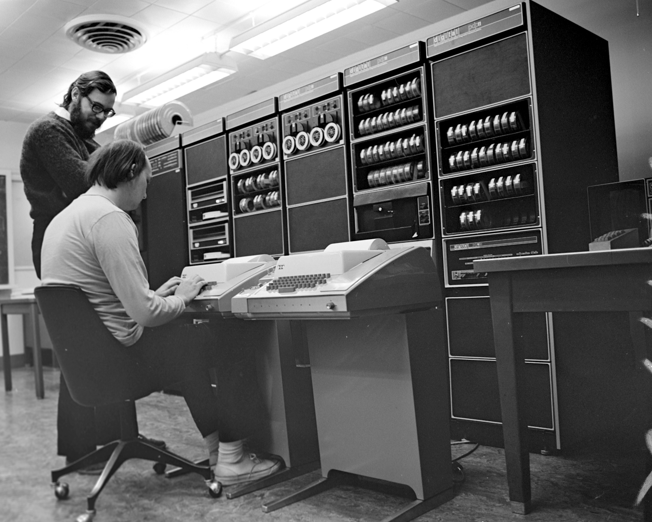
The Influence of UNIX
Fostered an explosion of creativity with new tools, languages, applications, and derivative systems
Internet servers
Web browsers
Linux
iOS
Android
Unix (1969-71)
Ken Thompson and Dennis Ritchie
“… a system around which a fellowship can form.”
“… the size constraint has encouraged not only economy but a certain elegance of design.”

Slide 20
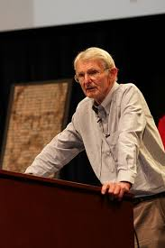
The Unexcelled Guidance of Doug McIlroy
Head of the Computing Techniques Research Department at Bell Labs, the birthplace of the Unix operating system, 1965-1986
Pioneer of component-based software engineering
Macros pioneer with D. E. Eastwood
Invented Unix pipes
Wrote Unix tools spell, diff, sort, join, graph, speak, tr, etc.
“The real hero of programming
is the one who writes negative
code.”
M. Douglas McIlroy
A Research UNIX Reader:
Annotated Excerpts from the Programmer’s Manual
1971-1986

Slide 21
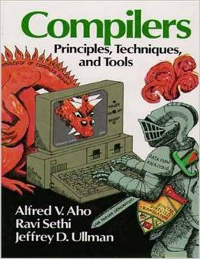
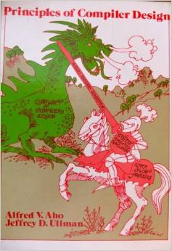
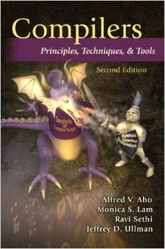
The Dragon Books Captured the Enormous Synergy Between Theory and Compiler Design
1986
type checking
run-time organization
automatic code
generation
1977
finite automata
grammars
lex & yacc
syntax-directed translation
2007
garbage collection
optimization
parallelism
interprocedural analysis

Slide 22
Phases of a Compiler
source
program
target
program
Lexical
Analyzer
Syntax
Analyzer
Semantic
Analyzer
Interm.
Code
Gen.
Code
Optimizer
Code
Gen.
token
stream
syntax
tree
annotated
syntax
tree
interm.
rep.
interm.
rep.
Symbol Table
Alfred V. Aho, Monica S. Lam, Ravi Sethi and Jeffrey D. Ullman
Compilers: Principles, Techniques, & Tools
Addison Wesley, 2007

Slide 23
Front End Compiler Component Generators
lex
specification
yacc
specification
Lexical
Analyzer
Generator
LEX
Syntax
Analyzer
Generator
YACC
Lexical
Analyzer
Syntax
Analyzer
source
program
token
stream
syntax
tree
Michael E. Lesk and Eric Schmidt
Lex – A Lexical Analyzer Generator
CSTR 39, Bell Labs 1975
Stephen C. Johnson
Yacc-Yet Another Compiler Compiler
CSTR 32, Bell Labs, 1975

Slide 24
A Few Lex/Yacc-based Languages
ampl, mathematical programming (R. Fourer, D. Gay and B. Kernighan)
awk, for file-processing (A. Aho, P. Weinberger and B. Kernighan)
C++, an object-oriented extension of C (B. Stroustrup)
efl, extended Fortran language (S. Feldman)
eqn, for typesetting equations (B. Kernighan and L. Cherry)
f77, a Fortran 77 compiler (S. Feldman and P. Weinberger)
grap, for typesetting graphs (B. Kernighan and J. Bentley)
hoc, a C-like “desk-calculator” language (B. Kernighan and R. Pike)
ideal, for typesetting line drawings (C. Van Wyk)
make, for building software (S. Feldman)
pcc, a portable C compiler (S. Johnson)
pic, for typesetting line drawings (B. Kernighan)
ratfor, C-like syntax for Fortran (B. Kernighan)
struct, for converting Fortran to Ratfor (B. Baker)

Slide 25
Programming Languages Today
Today there are thousands of programming languages.
The website http://www.99-bottles-of-beer.net
has programs in over 1,500 different
programming languages and variations to
generate the lyrics to the song “99 Bottles
of Beer.”

Slide 26
“99 Bottles of Beer”
99 bottles of beer on the wall, 99 bottles of beer.
Take one down and pass it around, 98 bottles of beer on the wall.
98 bottles of beer on the wall, 98 bottles of beer.
Take one down and pass it around, 97 bottles of beer on the wall.
.
.
.
2 bottles of beer on the wall, 2 bottles of beer.
Take one down and pass it around, 1 bottle of beer on the wall.
1 bottle of beer on the wall, 1 bottle of beer.
Take one down and pass it around, no more bottles of beer on the wall.
No more bottles of beer on the wall, no more bottles of beer.
Go to the store and buy some more, 99 bottles of beer on the wall.
[Traditional]

Slide 27
“99 Bottles of Beer” in C++
#include <iostream>
using namespace std;
int main()
{
int bottles = 99;
while ( bottles > 0 )
{
cout << bottles << " bottle(s) of beer on the wall," << endl;
cout << bottles << " bottle(s) of beer." << endl;
cout << "Take one down, pass it around," << endl;
cout << --bottles << " bottle(s) of beer on the wall." << endl;
}
return 0;
}
[Tim Robinson, http://www.99-bottles-of-beer.net/language-c++-109.html]

Slide 28
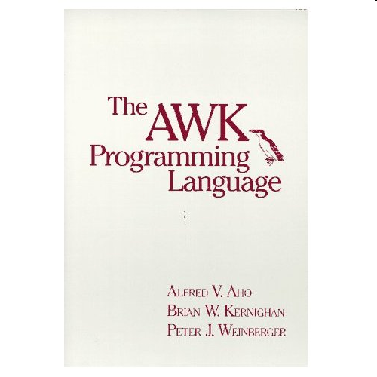
The Birth of AWK
AWK is a scripting language for routine data-processing tasks designed by Al Aho, Brian Kernighan, Peter Weinberger at Bell Labs around 1977
Each of the co-designers had slightly different motivations
Aho wanted a generalized grep
Kernighan wanted a programmable editor
Weinberger wanted a database query tool
All co-designers wanted a simple, easy-to-use language

Slide 29
Structure of an AWK Program
An AWK program is a sequence of pattern-action statements
pattern { action }
pattern { action }
. . .
Each pattern is a boolean combination of regular, numeric, and string expressions
An action is a C-like program
If there is no { action }, the default is to print the line
Invocation
awk ‘program’ [file1 file2 . . . ]
awk –f progfile [file1 file2 . . . ]

Slide 30
AWK’s Model of Computation: Pattern-Action Programming
for each file
for each line of the current file
for each pattern in the AWK program
if the pattern matches the input line then
execute the associated action

Slide 31
Some Useful AWK “One-liners”
Print the total number of input lines
END { print NR }
Print the last field of every input line
{ print $NF }
Print each input line preceded by its line number
{ print NR, $0 }
Print all non-empty input lines
NF > 0
Print all unique input lines
!x[$0]++

Slide 32
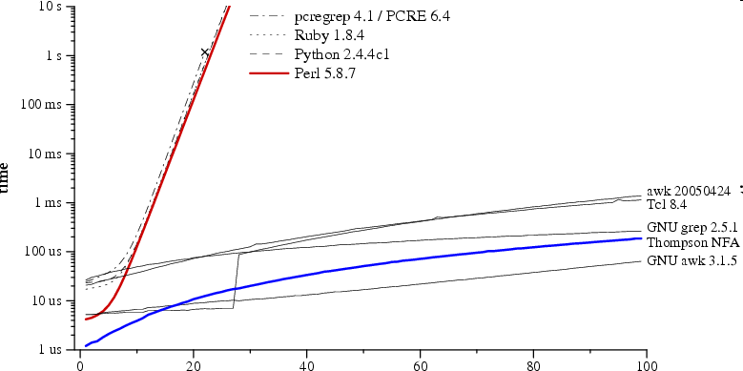
Comparison: Regular Expression Pattern Matching in Perl, Python, Ruby vs. AWK
Time to check whether a?^{n}a^{n} matches a^{n}
regular expression and text size n
Russ Cox, Regular expression matching can be simple and fast (but is slow in Java, Perl, PHP, Python, Ruby, ...) [http://swtch.com/~rsc/regexp/regexp1.html, 2007]

Slide 33
“99 Bottles of Beer” in AWK (bottled version)
BEGIN{
split( \
"no mo"\
"rexxN"\
"o mor"\
"exsxx"\
"Take "\
"one dow"\
"n and pas"\
"s it around"\
", xGo to the "\
"store and buy s"\
"ome more, x bot"\
"tlex of beerx o"\
"n the wall" , s,\
"x"); for( i=99 ;\
i>=0; i--){ s[0]=\
s[2] = i ; print \
s[2 + !(i) ] s[8]\
s[4+ !(i-1)] s[9]\
s[10]", " s[!(i)]\
s[8] s[4+ !(i-1)]\
s[9]".";i?s[0]--:\
s[0] = 99; print \
s[6+!i]s[!(s[0])]\
s[8] s[4 +!(i-2)]\
s[9]s[10] ".\n";}}
[Wilhem Weske, http://www.99-bottles-of-beer.net/language-awk-1910.html

Slide 34
“99 Bottles of Beer” in the Whitespace language
[Andrew Kemp, http://compsoc.dur.ac.uk/whitespace/]

Slide 35
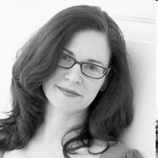
Conlangs: Made-Up Languages
Okrent lists 500 invented languages including:
Lingua Ignota [Hildegaard of Bingen, c. 1150]
Esperanto [L. Zamenhof, 1887]
Klingon [M. Okrand, 1984]
Huq Us'pty G'm (I love you)
Proto-Central Mountain [J. Burke, 2007]
Dritok [D. Boozer, 2007]
Language of the Drushek, long-tailed beings with
large ears and no vocal cords
[Arika Okrent, In the Land of Invented Languages, 2009]
[http://www.inthelandofinventedlanguages.com]

Slide 36
Why Are There So Many Languages?
One language cannot serve all application areas well
e.g., programming web pages (JavaScript)
e.g., electronic design automation (VHDL)
e.g., parser generation (YACC)
Programmers often have strongly held opinions about
what makes a good language
how programming should be done
There is no universally accepted metric for a good language!

Slide 37
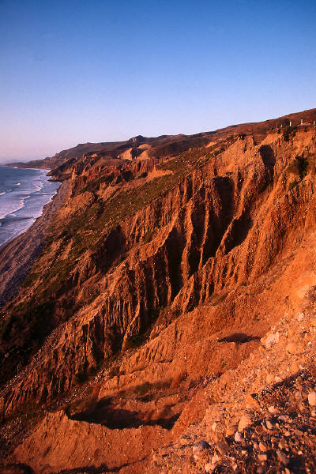
Evolutionary Forces on Languages
Increasing diversity of applications
Stress on increasing programmer productivity and shortening time to market
Need to improve software security, reliability and maintainability
Emphasis on mobility and distribution
Support for parallelism and concurrency
New mechanisms for modularity
Trend toward multi-paradigm programming

Slide 38
Evolution of Programming Languages
1970
Fortran
Lisp
Cobol
Algol 60
APL
Snobol 4
Simula 67
Basic
PL/1
Pascal
2015
Java
C
C++
Objective-C
C#
JavaScript
PHP
Python
Visual Basic
Visual Basic .NET
TIOBE Index
April 2015
Notes:
Note the extraordinary influence of C on today’s programming languages.

Slide 39
Towards More Reliable Software
How can we get reliable software from unreliable programmers?

Slide 40
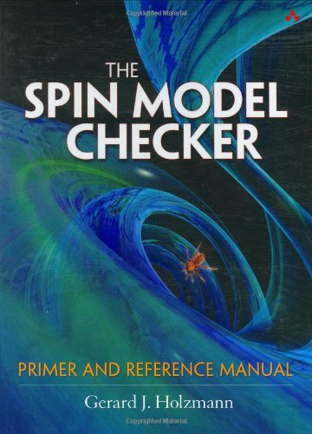
The Spin Software Verification Tool
Developed by Gerard Holzmann at Bell Labs starting in 1980
Tool has been used worldwide for the formal verification of multi-threaded software applications
Available as an open-source software verification tool
Used to help verify the software in NASA’s Mars Curiosity Rover

Slide 41
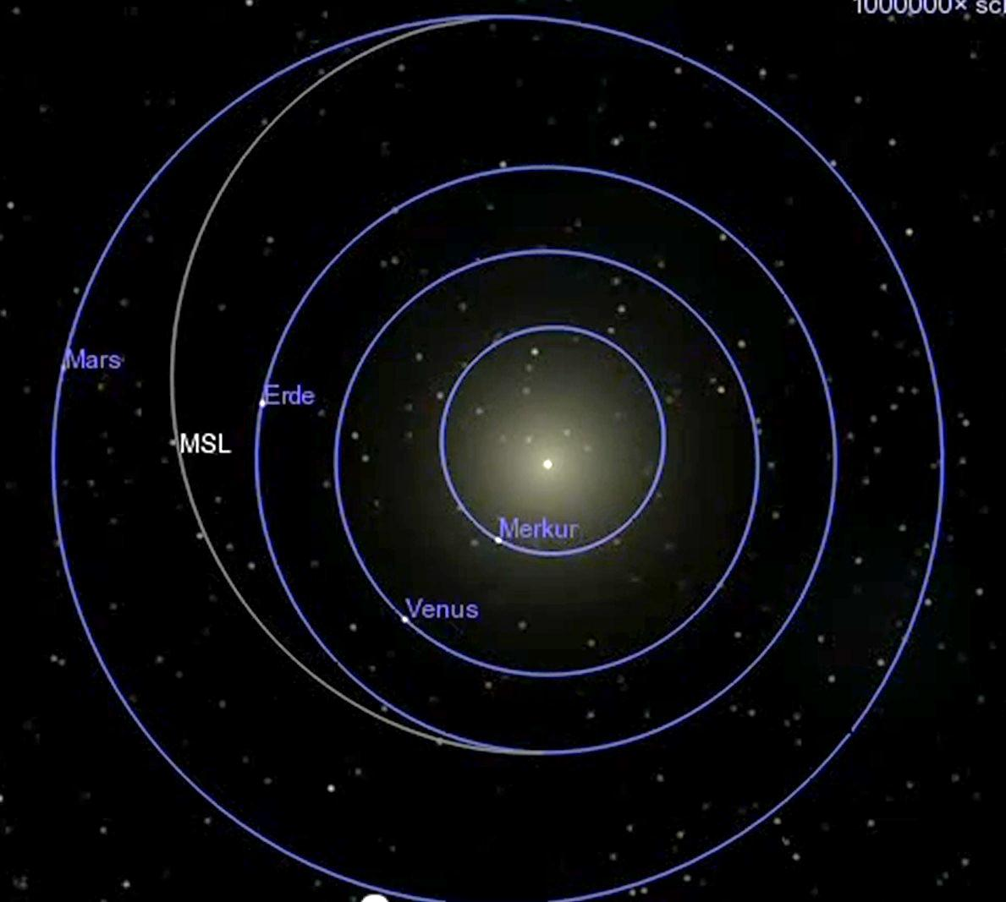
Mission to
Mars…
5 August 2012
Mars
Earth
Sun
Mercury
Venus
26 November 2011
a trip of
350 Million miles

Slide 42
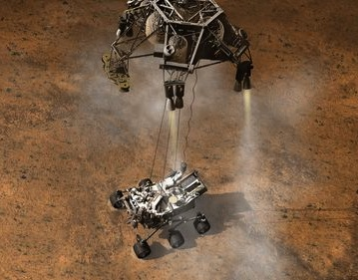
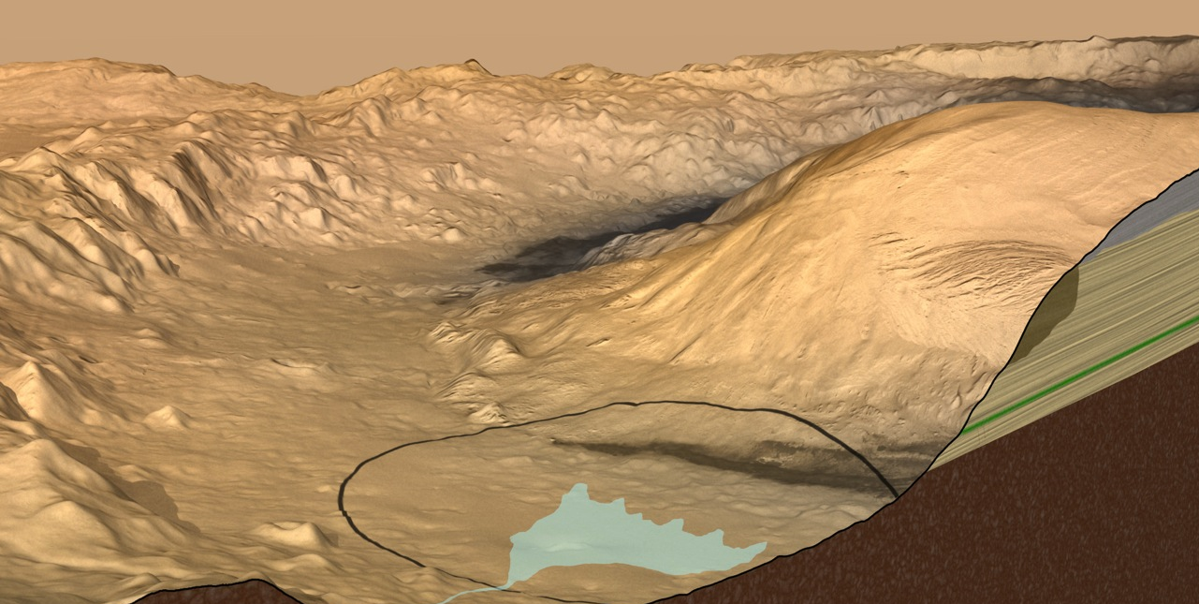
Destination: Gale Crater
an old streambed
12 x 4.3 mile landing ellipse

Slide 43
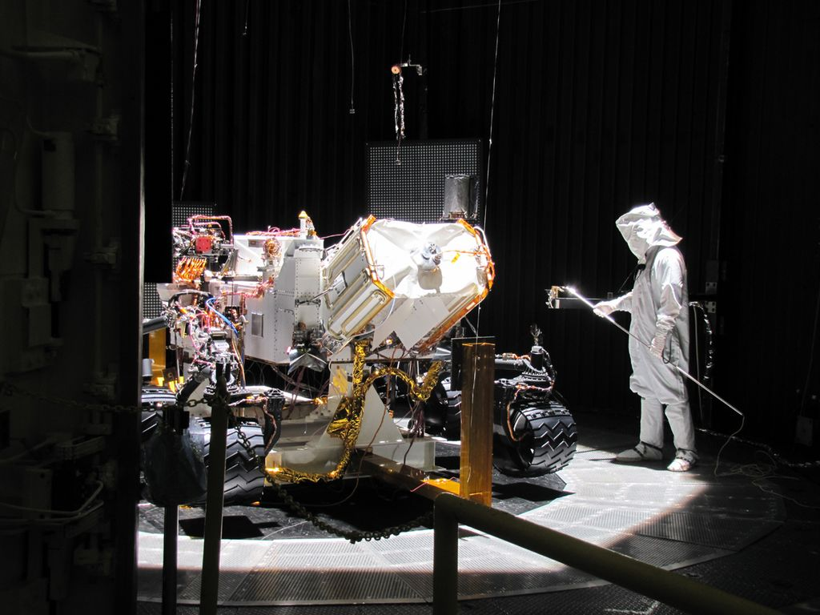
How Do You Make Sure That It Works?

Slide 44
And What About the Software?
3 million lines of C code
120 parallel threads
VxWorks tasks
2 CPUs (1 spare)
5 years development time, with
a team of 40 software engineers
< 10 lines of code per hour
1 customer, 1 use:
it has to work the first time
How do you get it right?
Gerard Holzmann

Slide 45
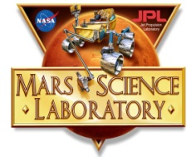
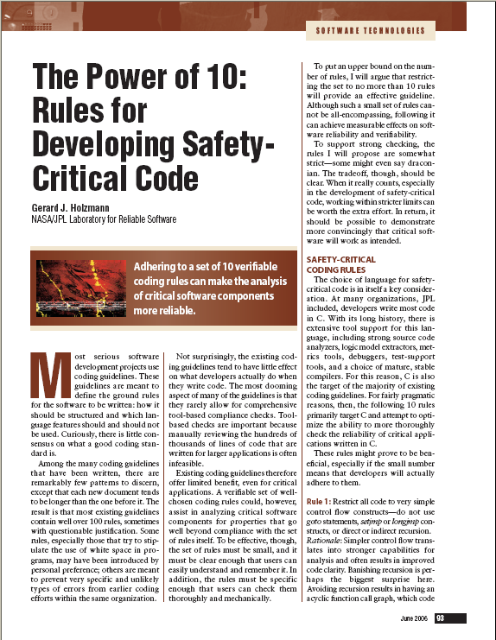
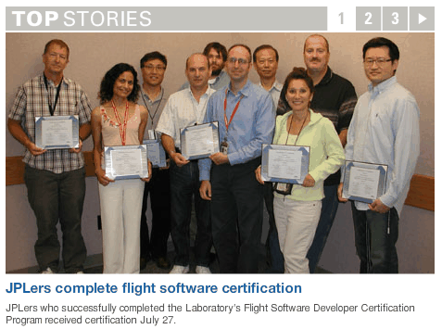
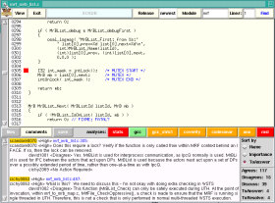
Getting it right some of the things done differently from previous missions
Defined a new risk-based Coding Standard with tool-based compliance checks
Introduced a Certification program for flight software developers
Introduced routine use of strong Static Source Code Analysis tools
Defined a new Code Review process and Tool (scrub), integrated with static analysis
Made use of formal analysis for key subsystems with Logic Model Checking

Slide 46
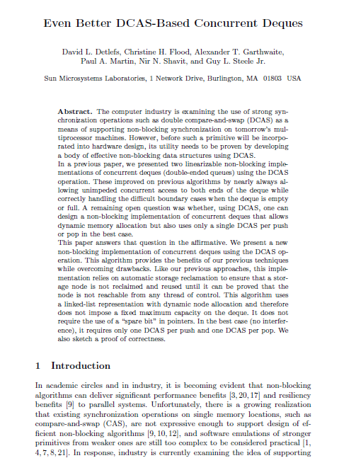
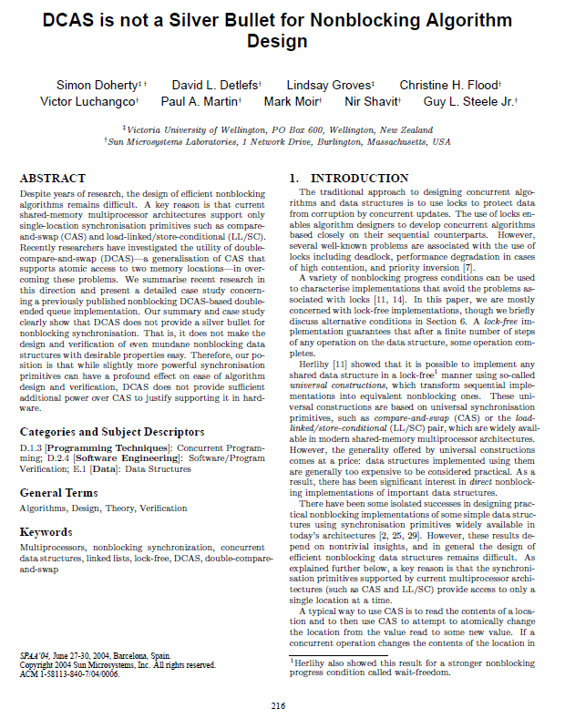
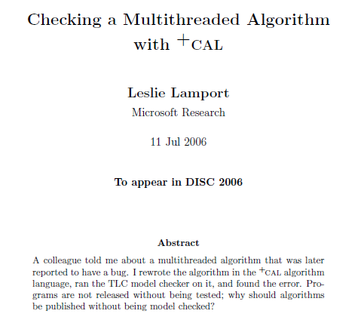
Verifying Concurrent Code What is the State-of-the-art?
2000
a small example
2004
2006
2000: manual proof (a few months)
proof sketch: 5 pages, 7 Lemmas, 5 Theorems
2004: new proof with PVS theorem prover (3 months)
2006: +CAL model & TLA+ proof (a few days)
Is it any easier today?

Slide 47
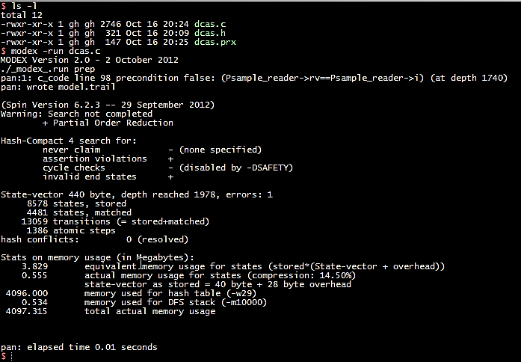
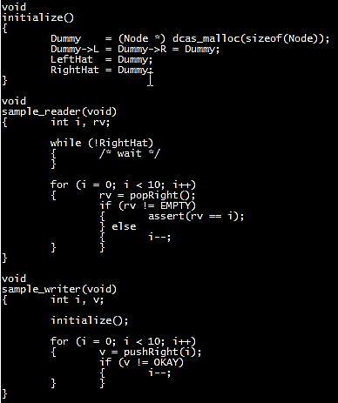
Logic Verification
$ verify dcas.c
..report assertion violation
$
this takes C code as input
it uses the modex model-extractor to generate
a formal model mechanically, and then runs the
Spin model-checker to check if the assertion
can be violated
all steps together take about 10 seconds
the verification step itself takes a fraction of that
Gerard Holzmann

Slide 48
Cutting to the Chase
In the first (Earth) year on the surface of Mars the previous mission lost 26 days of operation to software bugs.
In the first year on Mars the MSL mission lost 1 day to a single bug.

Slide 49
Credit: Intel Corporation
Notes:
49
What will this slide look like in another 20 years?

Slide 50
Parting Questions
How much of human behavior can we impact with software?

Slide 51
Final Parting Question
How much of human behavior can we simulate with software?
Notes:
Software with consciousness?

