Slide 1
Lecture 2: Median trick + Chernoff, Distinct Count, Impossibility Results
COMS E6998-9 F15
Notes:
Left to the title, a presenter can insert his/her own image pertinent to the presentation.

Slide 2
Administrivia, Plan
Website moved:
sublinear.wikischolars.columbia.edu/main
Piazza: sign-up!
Plan:
Median trick, Chernoff bound (from Tue)
Distinct Elements Count
Impossibility Results

Slide 3
Last Lecture
Counting frequency
Morris Algorithm:
Initialize $X=0$
On increment, $X=X+1$ with prob. $1/2^{X}$
Estimator: $2^{X}−1$
IP | Frequency
160.39.142.2 | 3
Morris: | $$Var=O(n^{2})$$ | Failure prob: 0.1
Morris+: Average of $k=O(1/ε^{2})$ | $$Var=O\left(n^{2}/k\right)$$ use Chebyshev for $1+ε$ approx. | Failure prob: 0.1
Morris++: Median of $m=O\left(\log{\frac{1}{δ}}\right)$ | use Chernoff | Failure prob: $δ$

Slide 4
“Median trick”
Chernoff/Hoeffding bounds:
$X_{1},X_{2},…X_{m}$ are independent r.v. in $\{0,1\}$
$μ=E\left[\sum_{i}{X_{i}}\right]$
$ε∈[0,1]$
$\operatorname{Pr}\left[\left|\sum_{i}{X_{i}−μ}\right|>εμ\right]≤2e^{−ε^{2}μ/3}$
Algorithm $A$:
output $∈$ correct range
with 90% probability
Algorithm $A^{∗}$
output $∈$ correct range
with $1−δ$ probability
Median trick:
Repeat $A$ for $m=O\left(\log{\frac{1}{δ}}\right)$ times
Take median of the answers

Slide 5
Using Chernoff for Median trick
Chernoff: $\operatorname{Pr}\left[\left|\sum_{i}{X_{i}−μ}\right|>εμ\right]≤2e^{−ε^{2}μ/3}$
Define $X_{i}$ = 1 iff $i^{th}$ copy of $A$ is correct
$E\left[X_{i}\right]=0.9$ ($A$ is correct with 90% prob.)
$μ=0.9m$
New alg $A^{∗}$ is correct when $∑X_{i}>0.5m$
Use Chernoff to bound:
$\operatorname{Pr}\left[\left|∑X_{i}−μ\right|>0.4m\right]=$
$\operatorname{Pr}\left[\left|∑X_{i}−μ\right|>\frac{0.4}{0.9}μ\right]≤e^{−c⋅0.9 m}<δ$
for $m=O\left(log\frac{1}{δ}\right)$

Slide 6
Problem: Distinct Elements
Streaming elements from $[n]$
Approximate the number of
elements with non-zero freq.
Length of stream = $m$
Space required?
$O(n)$ bits
$O(m⋅log n)$ bits
IP | Frequency
1 | 3
2 | 2
3 | 0
4 | 9
5 | 0
… | 0
$$n$$ | 1

Slide 7
Algorithm for approximating DE
Main tool: hash function
$h:\left[n\right]→[0,1]$
$h(i)$ random in $[0,1]$
Algorithm [Flajolet-Martin 1985]
Init $z=1$
When see element $i$:
$z=min⁡\{z, h(i)\}$
Estimator:
$\frac{1}{z}−1$
Where from?
Will return later…

Slide 8
Analysis
Algorithm DE:
Init: $z=1$
when see element $i$:
$z=min⁡\{z,h\left(i\right)\}$
Estimator:
$\frac{1}{z}−1$
Let $d$ = count of dist. elm.
Claim 1: $E\left[z\right]=\frac{1}{d+1}$
Proof:
$z$ = minimum of $d$ random numbers in [0,1]
Pick another random number $a∈[0,1]$
What’s the probability $a<z$ ?
1) exactly $z$
2) probability it is smallest among $d+1$ reals: $\frac{1}{d+1}$
5
7
2
$$h(5)$$
$$h(7)$$
$$h(2)$$
$$1/(d+1)$$

Slide 9
Analysis 2
Algorithm DE:
Init: $z=1$
when see element $i$:
$z=min⁡\{z,h\left(i\right)\}$
Estimator:
$\frac{1}{z}−1$
Need variance too…
Can prove
$var\left[z\right]≤2/d^{2}$
How do we get $1+ε$ approximation though?
We can take $z=\frac{1}{k}\left(z_{1}+z_{2}+…z_{k}\right)$
for independent $z_{1},…z_{k}$

Slide 10
Alternative: Bottom-k
Algorithm DE:
Init: $z=1$
when see element $i$:
$z=min⁡\{z,h\left(i\right)\}$
Estimator:
$\frac{1}{z}−1$
Bottom-k alg. [BJKS’02]:
Init ($z_{1},z_{2},…z_{k})=1$
Keep $k$ smallest hashes seen
$z_{1}≤z_{2}≤…z_{k}$
Estimator: $\hat{d}=\frac{k}{z_{k}}$
Proof: will prove
Probability that $\hat{d}>\left(1+ε\right)d$ is 0.05
Probability that $\hat{d}<\left(1−ε\right)d$ is 0.05
Overall only 0.1 probability $\hat{d}$ outside the correct range

Slide 11
Analysis for Bottom-k
Algorithm Bottom-k:
Init: $z_{1},…z_{k}=1$
Keep $k$ smallest hashes seen using $z_{1},…z_{k}$
Estimator:
$\hat{d}=\frac{k}{z_{k}}$
Compute: $\operatorname{Pr}\left[\hat{d}>\left(1+ε\right)d\right]$
Suppose we see {1…d}
Define $X_{i}=1$ iff $h\left(i\right)<\frac{k}{\left(1+ε\right)d}$
Then: $\hat{d}>\left(1+ε\right)d$ iff $\sum_{i}{X_{i}}>k$
We have:
$E\left[X_{i}\right]=\frac{k}{\left(1+ε\right)d}$
$E\left[\sum_{i}{X_{i}}\right]=d⋅E\left[X_{i}\right]=\frac{k}{1+ε}$
$var\left[\sum_{i}{X_{i}}\right]=d⋅var \left[X_{i}\right]≤d⋅E\left[X_{1}^{2}\right]≤\frac{k}{1+ε}≤k$
By Chebyshev:
$\operatorname{Pr}\left[\left|∑X_{i}−\frac{k}{1+ε}\right|>\sqrt{20k}\right]≤0.05$
or: $\operatorname{Pr}\left[∑X_{i}>\frac{k}{1+ε}+\sqrt{20k}\right]≤0.05$
requires $d>k$
Implied by $∑X_{i}>k$
for $k=Ω(1/ε^{2})$

Slide 12
Hash functions in Streaming
We used
$$h:\left[n\right]→[0,1]$$
Issue 1: reals?
Issue 2: how do we store it?
Issue 1:
Ok with: $h:\left[n\right]→\left\{0,\frac{1}{M},\frac{2}{M},\frac{3}{M},…1\right\}$ for $M≫n^{3}$
Probability that $d≤n$ random numbers collide:
at most $1/n$

Slide 13
Issue 2: bounded randomness
Pairwise independent hash functions
Definition: $h:\left[n\right]→\left\{1,2,…M\right\}$ s.t.
for all $i≠j$ and $a,b∈[M]$
$\operatorname{Pr}\left[h\left(i\right)=a∧h\left(j\right)=b\right]=1/M^{2}$
(i.e., like random on pairs)
Such hash function enough:
Variance cares only about pairs!
We defined $X_{i}=1$ iff $h\left(i\right)<…$
And computed
$var\left[∑X_{i}\right]=E\left[{\left(∑X_{i}\right)}^{2}\right]−{\left(E\left[∑X_{i}\right]\right)}^{2}$
$=E\left[X_{1}X_{1}+X_{1}X_{2}+…\right]−{\left(E\left[∑X_{i}\right]\right)}^{2}$
same for fully random $h$
and pairwise independent $h$

Slide 14
Pairwise-Independent: example
Definition: $h:\left[n\right]→\left\{0,1,…M−1\right\}$ s.t.
for all $i≠j$ and $a,b∈\{0,1,…M−1\}$
$\operatorname{Pr}\left[h\left(i\right)=a∧h\left(j\right)=b\right]=1/M^{2}$
(A) construction:
Suppose $M$ is prime
Pick $p,q∈\{0,1,…M−1\}$
$h\left(i\right)=pi+q (mod M)$
Space: only $O\left(\log{M}\right)=O(\log{n})$ bits
Proof of correctness:
$h\left(i\right)=a$ and $h\left(j\right)=b$ : system of 2 equations in 2 unknowns ($p,q$)
Exactly one pair $(p,q)$ satisfies it
Probability it is chosen: exactly $1/M^{2}$

Slide 15
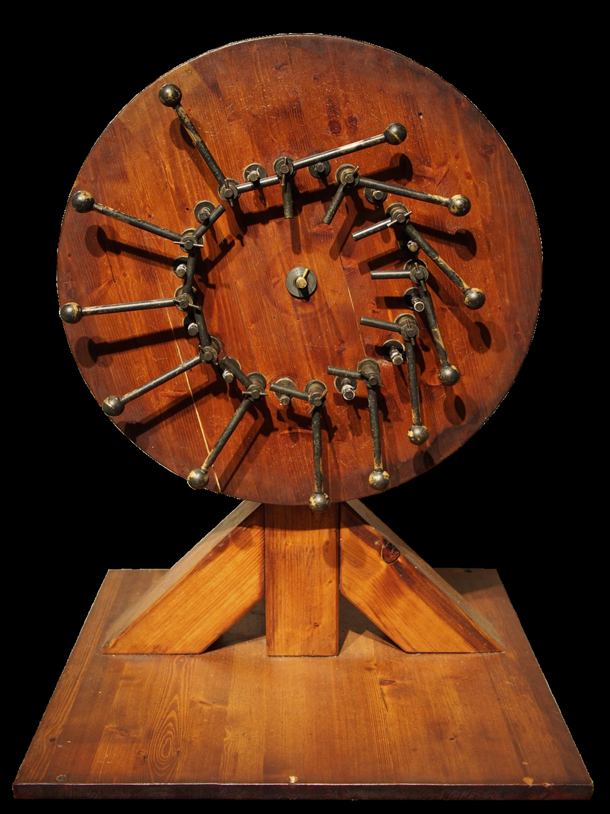
Impossibility Results
Relaxations:
Approximation
Randomization
Need both for
space $≪min⁡\{n,m\}$

Slide 16
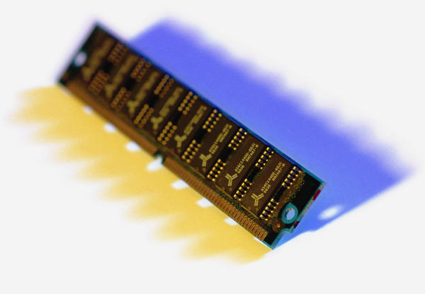
Deterministic Exact Won’t Work
Suppose algorithm $A$, estimator $R$
uses space $s≪n,m$
We build the following stream:
Let vector $x∈{\left\{0,1\right\}}^{n}$
$i$ in stream iff $x_{i}=1$
Run $A$ on it and let $σ$ be memory content
$$x=$$
1 | 0 | 1 | 0 | 1 | 1 | 1 | 1 | 1 | 1 | 0
1
$d$ didn’t change
$⇒$ $x_{1}=1$
1 | 3 | 5 | 6 | 7 | 8 | 9 | 10
$$σ$$
$$σ$$
2
$d$ increased
$⇒$ $x_{2}=0$
$$σ$$

Slide 17
Deterministic Exact Won’t Work
Using$σ$, can recover entire $x$ !
“$σ$= encoding of a string $x$ of length $n$”
But $σ$ has only $s≪n$ bits!
Can think $A:{\left\{0,1\right\}}^{n}→{\left\{0,1\right\}}^{s}$
1
$d$ didn’t change
$⇒$ $x_{1}=1$
1 | 3 | 5 | 6 | 7 | 8 | 9 | 10
$$σ$$
$$σ$$
2
$d$ increased
$⇒$ $x_{2}=0$
$$σ$$

Slide 18
Deterministic Exact Won’t Work
Using$σ$, can recover entire $x$
“$σ$ = encoding of a string $x$ of length $n$”
But $σ$ has only $s≪n$ bits!
Can think $A:{\left\{0,1\right\}}^{n}→{\left\{0,1\right\}}^{s}$
Must be injective
Otherwise, suppose $A\left(x\right)=A\left(x^{′}\right)=σ$
The recovery implies $x=x′$
Hence $s≥n$

Slide 19
Deterministic Approx Won’t Too
Similar: use $A$ to compress $x$ from a code
Code: set $T⊂{\left\{0,1\right\}}^{n}$ s.t.
$\left|y∖x\right|≥n/6$ for all distinct $x,y∈T$
$\left|T\right|≥2^{Ω\left(n\right)}$
Use $A$ to encode an input $x$ into $σ$
For each $y∈T$ check whether $x=y$:
Append $y$
If $\hat{d}′>1.01 \hat{d}$, then $x≠y$
By injectivity of $A$ on $T$: $2^{s}≥|T|$ or $s=Ω\left(n\right)$
$$x=$$
1 | 0 | 1 | 0 | 1 | 1 | 1 | 1 | 1 | 1 | 0
$$y=$$
0 | 1 | 0 | 1 | 0 | 0 | 1 | 1 | 1 | 1 | 1
1 | 3 | 5 | 6 | 7 | 8 | 9 | 10
2 | 4 | 7 | 8 | 9 | 10 | 11
$$σ′=A(x+y)$$
$$\hat{d}′=R(σ′)$$
$$σ=A(x)$$
$$\hat{d}=R(σ)$$
$$σ=A(x)$$

Slide 20
Concluding Remarks
Median trick + Chernoff
Distinct Elements
Can also store hashes $h(i)$ approximately (store number of leading zeros)
$O(loglog n)$ bit per hash value
Plus other bells and whisles
HyperLogLog
Impossibility results
Can also prove randomized, exact won’t work

