Slide 1
Lecture 5: Precision Sampling (cont), Streaming for Graphs
Notes:
Left to the title, a presenter can insert his/her own image pertinent to the presentation.

Slide 2
Plan
Precision Sampling (continuation)
Streaming for graphs
Scriber?

Slide 3
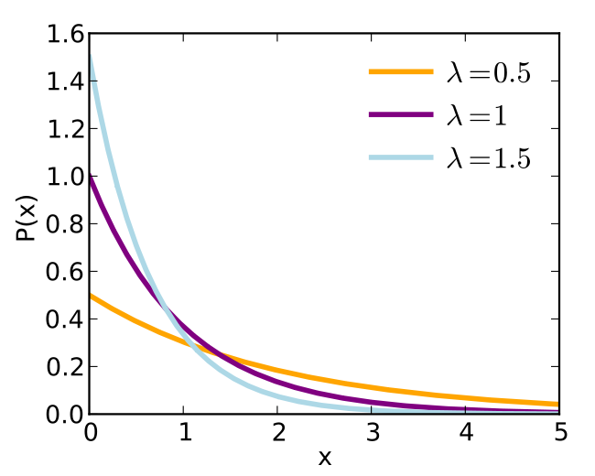
Precision Sampling: Algorithm
Precision Sampling Lemma: can get with 90% success:
O(1) additive error and 1.5 multiplicative error:
$S/1.5−O\left(1\right)<\tilde{S}<1.5⋅S+O(1)$
with average cost equal to $O(log⁡n)$
Algorithm:
Choose each $u_{i}Exp(1)$ i.i.d.
Estimator: $\tilde{S}=\max_{i} {\tilde{a}}_{i}/u_{i}$.
Proof of correctness:
Claim 1: $\max{a_{i}/u_{i}}∼∑a_{i}/Exp(1)$
Hence, $\max{{\tilde{a}}_{i}/u_{i}}=\frac{∑a_{i}}{Exp\left(1\right)}±1$
Claim 2: Avg cost =$O(\log{n})$
$$Exp(1)∼e^{−x}$$

Slide 4
$p$-moments via Prec. Sampling
Theorem: linear sketch for $p$-moment with $O(1)$ approximation, and $O(n^{1−2/p}\log^{O(1)}{n})$ space (with 90% success probability).
Sketch:
Pick random $ri\{±1\}$, and $u_{i}∼Exp(1)$
let $y_{i}=f_{i}⋅r_{i}/u_{i}^{1/p}$
Hash into a hash table $S$,
$w=O(n^{1−\frac{2}{p}}\log^{O\left(1\right)}{n})$ cells
Estimator:
$\max_{j}{{\left|S\left[j\right]\right|}^{p}}$
Sketch $S$ is linear
$$u∼e^{−u}$$
$$f=$$
$$f1$$ | $$f2$$ | $$f3$$ | $$f4$$ | $$f5$$ | $$f6$$
$$y_{1}+y_{3}$$ | $$y_{4}$$ | $$y_{2}+y_{5}+y_{6}$$
$$S=$$

Slide 5
Correctness of estimation
Theorem: $\max_{j}{{\left|S\left[j\right]\right|}^{p}}$ is $O(1)$ approximation with 90% probability, with
$w=O(n^{1−2/p} \log^{O\left(1\right)}⁡n)$ cells
Proof:
Use Precision Sampling Lem.
$a_{i}={\left|f_{i}\right|}^{p}$
$∑a_{i}=∑{\left|f_{i}\right|}^{p}=F_{p}$
${\tilde{a}}_{i}/u_{i}={\left|S\left[h\left(i\right)\right]\right|}^{p}$
Need to show $|a_{i}−{\tilde{a}}_{i}|$ small
more precisely: $\left|\frac{{\tilde{a}}_{i}}{u_{i}}−\frac{a_{i}}{u_{i}}\right|≤εF_{p}$
Algorithm PrecisionSamplingFp:
Initialize(w):
array S[w]
hash func $h$, into [w]
hash func $r$, into {$±1$}
reals $u_{i}$, from $Exp$ distribution
Process(vector $f∈ℜ^{n}$):
for(i=0; i<n; i++)
S[$h(i)$] += $f_{i}⋅\frac{r_{i}}{u_{i}^{1/p}}$;
Estimator:
$\max_{j}{{\left|S[j]\right|}^{p}}$

Slide 6
Correctness 2
$$f1$$ | $$f2$$ | $$f3$$ | $$f4$$ | $$f5$$ | $$f6$$
Claim: $\left|S{\left[h\left(i\right)\right]}^{p}−f_{i}^{p}/u_{i}\right|≤O(εF_{p})$
Consider cell $z=h(i)$
$S\left[z\right]=\frac{f_{i}r_{i}}{u_{i}^{1/p}}+C$
How much chaff $C$ is there?
$C=\sum_{j≠i^{∗}}{y_{j}}⋅ χ\left[h\left(j\right)=z\right]$
$E\left[C^{2}\right]=… ≤ ||y||^{2}/w$
What is $||y||^{2}$ ?
$E_{u}||y||^{2} ≤ ||f||^{2}⋅E\left[\frac{1}{u^{2/p}}\right]= ||f||^{2}⋅O\left(\log{n}\right)$
$||f||^{2}≤n^{1−2/p}||f||_{p}^{2}$
By Markov’s: $C^{2}≤ ||f||_{p}^{2}⋅n^{1−2/p}⋅O(\log{n})/w$ with probability >90%
Set $w=\frac{1}{ε^{2/p}}n^{1−2/p}⋅O(\log{n})$, then
${\left|C\right|}^{p}≤||f||_{p}^{p}⋅ε=εF_{p}$
$$y_{1}+y_{3}$$ | $$y_{4}$$ | $$y_{2}+y_{5}+y_{6}$$
$$S=$$
$$y_{i} = f_{i}⋅r_{i}/u_{i}^{1/p}$$
where $r_{i}\{±1\}$
$u_{i}$ exponential r.v.

Slide 7
Correctness (final)
Claim: $\left|S{\left[h\left(i\right)\right]}^{p}−f_{i}^{p}/u_{i}\right|≤O(εF_{p})$
$S{\left[h\left(i\right)\right]}^{p}={\left(\frac{f_{i}}{u_{i}^{1/p}}+C\right)}^{p}$
where $C=\sum_{j≠i^{∗}}{y_{j}}⋅ χ\left[h\left(j\right)=h(i)\right]$
Proved:
$E\left[C^{2}\right]≤||y||^{2}/w$
this implies $C^{p}≤εF_{p}$ with 90% for fixed $i$
But need for all $i$ !
Want: $C^{2}≤β||y||^{2}/w$ with high probability for some smallish $β$
Can indeed prove for $β=O(\log^{2}{n})$ with strong concentration inequality (Bernstein).

Slide 8
Recap: frequency moments
$p$-moment for $p>2$
Via Precision Sampling
Estimate of sum from poor estimates
complexity
$$O_{ε}(\log{n})$$
$$O_{ε}\left(n^{1−2/p}\log{n}\right)$$
$$0$$
$$1$$
$$2$$
$$∞$$
Precision Sampling
later in class
Not possible
Proxy: heavy hitters
CountSketch
Distinct count
[AMS’96] Tug-Of-War

Slide 9
Streaming for Graphs
Notes:
Left to the title, a presenter can insert his/her own image pertinent to the presentation.

Slide 10
Streaming for Graphs
Graph $G$
$n$ vertices
$m$ edges
Stream:
list of edges
(e.g., on a hard drive)
( , )
( , )
( , )
( , )
( , )
( , )

Slide 11
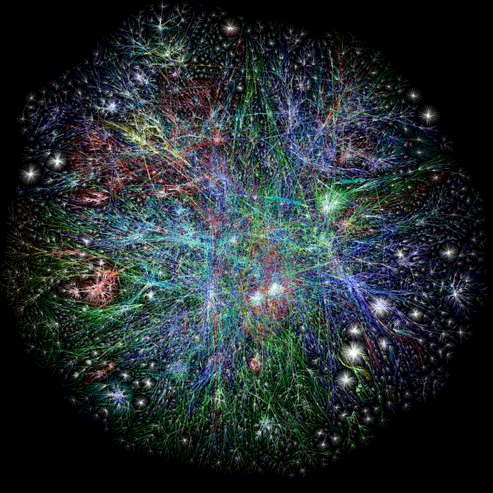
Graphs
Web
Social graphs
Phone calls
Maps
Geographical data
…

Slide 12
Why streaming for graphs?
Want to run graph algorithms
graph stored on hard drive
A linear scan on hard MUCH more efficient than random access
Usual algorithms are usually random-access
think Breadth-First-Search
( , )
( , )
( , )
( , )
( , )
( , )

Slide 13
For which problems?
Most of usual-suspect algorithms use random-access
Questions:
Connectivity
Distances (similarities) between nodes
PageRank (stationary distribution of random walk)
Counting # of triangles (measure of clusterability)
Various other statistics
Matchings
Graph partitioning
…

Slide 14
Parameters for graph algorithms
E.g., for web can have
$n=1⋅{10}^{9}$ nodes
$m=100⋅{10}^{9}$ edges
Size of the workspace:
Aim: to use $\sim n$ space
or $O(n⋅\log{n})$
Still much less than $m$ (that could be up to $n2$)
$≪n$ is usually not achievable

Slide 15
Problem 1: connectivity
Check whether the graph is connected?
in $O(n)$ space
Idea:
Store minimum spanning tree
Algorithm:
Keep a subgraph $H$ (starts empty)
when see an edge $(i,j)$:
If $(i,j)$ does not create a cycle in $H$, add it to $H$
Space: $≤n−1$ edges only
Can use $H$ for:
Connectivity between 2 nodes
# connected components

Slide 16
Problem 2: distance
Given $s,t$, compute the distance between them
Up to approximation $α$, odd integer
Modification of the previous algorithm:
Keep a subgraph $H$
On edge $(i,j)$: if $d_{H}(i,j)>α$, add $(i,j)$ to $H$
Space?
All cycles in $H$ have length $≥α+2$
Thm [Bollobas]: then $\left|H\right|≤O\left(n^{1+\frac{2}{α+1}}\right)$
Few other results known!

Slide 17
Detour: Bollobas Theorem
Thm [Bollobas]: If all cycles of length $≥α+2$ then $\left|H\right|≤O\left(n^{1+\frac{2}{α+1}}\right)$
Simplified case: all nodes of degree $d$
Proof:
Suppose: $α=2k−1$
Explore a vertex $v$
At depth $k$: all nodes differ!
Hence $d^{k}≤n$
Or $d≤n^{1/k}$
$m≤n^{1+1/k}=n^{1+\frac{2}{α+1}}$

