Slide 1
Sampling in Graphs
Alexandr Andoni
(Microsoft Research)

Slide 2

Graph compression
$$≈$$
Why smaller graphs?
  use less storage space
  faster algorithms
  easier visualization

Slide 3


$≈$ ?
Preserve some structure
Cuts
approximately
Other properties:
  Distances, (multi-commodity) flows, effective resistances…
$$≈$$

Slide 4
Plan
1) Cut sparsifiers
2) More efficient cut sparsifiers
3) Node sparsifiers

Slide 5




Cut sparsifiers
$G$ have $n$ nodes, $m$ edges; unweighted
For any set $S$, ${cut}_{G}\left(S\right)≈{cut}_{H}\left(S\right)$
  up to $1+ε$ approximation
$$≈$$
$$G$$
$$H$$

Slide 6
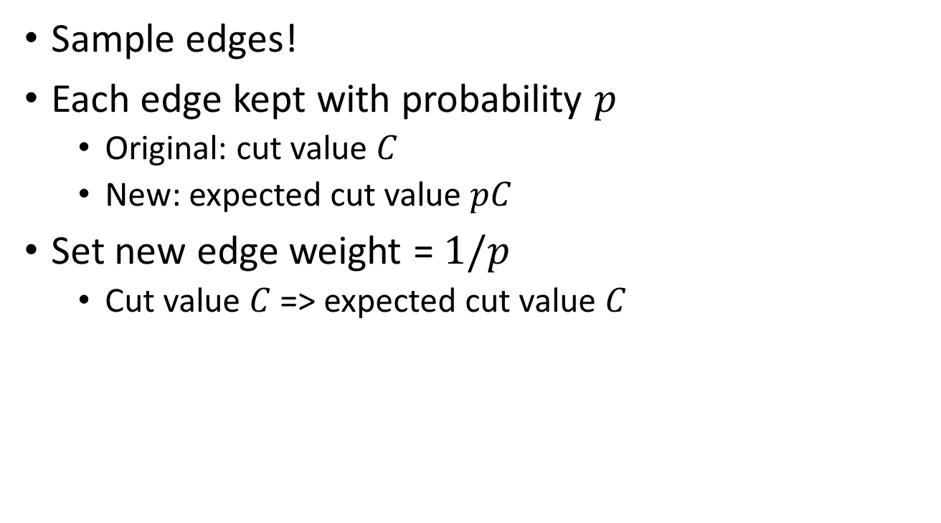
Approach?
[Karger’94,’96]:
Sample edges!
Each edge kept with probability $p$
  Original: cut value $C$
  New: expected cut value $pC$
Set new edge weight = $1/p$
  Cut value $C$ => expected cut value $C$

Slide 7
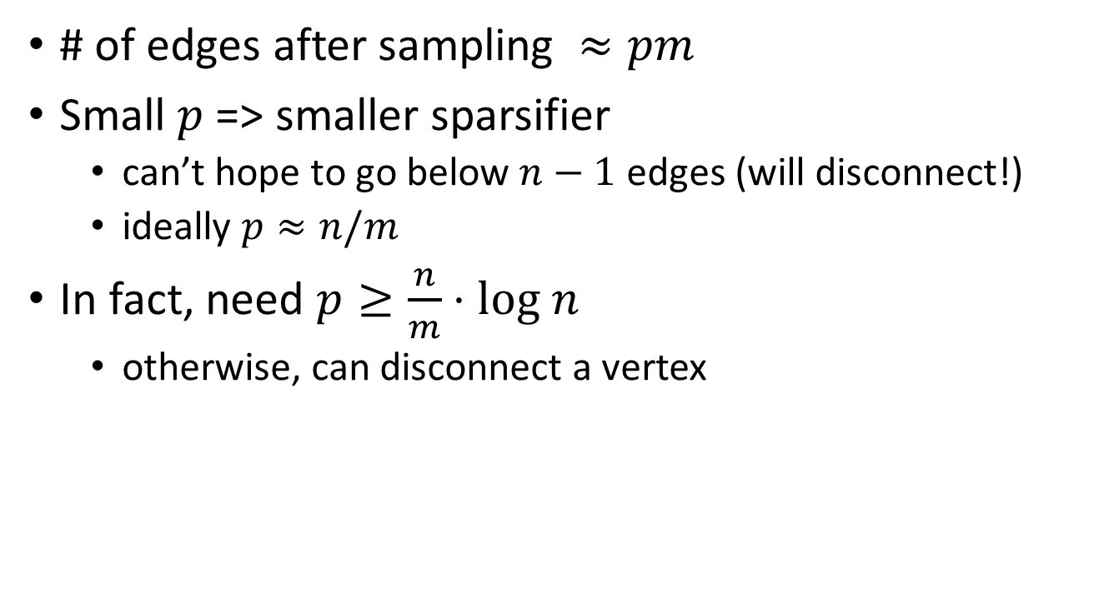
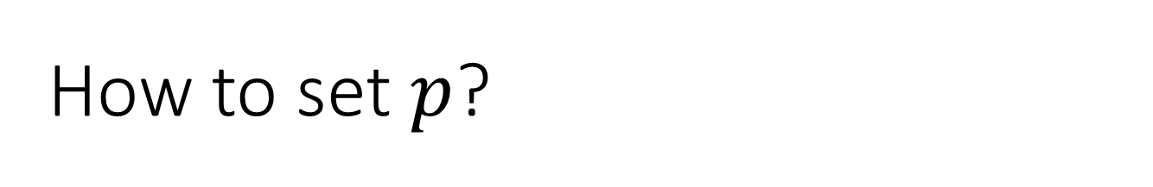
How to set $p$?
# of edges after sampling $≈pm$
Small $p$ => smaller sparsifier
  can’t hope to go below $n−1$ edges (will disconnect!)
  ideally $p≈n/m$
In fact, need $p≥\frac{n}{m}⋅log n$
  otherwise, can disconnect a vertex

Slide 8

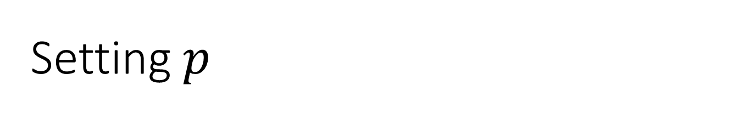
Setting $p$
Can we get away with $p=\frac{n}{m}log n$ ?
Issue: small cuts
Settle for:
  $p=\frac{s}{c}log n$, where
  $c$ = is min-cut in the graph
  $s$ = oversampling constant
  any cut will retain at least $s\log{n}$ edges in expectation

Slide 9


Concentration
Usually, will have:
  expectation: ok (by “correct” rescaling)
  hard part: concentration
    up to $1+ε$ factor
Chernoff bound:
given r.v. $X_{1},X_{2},…X_{k}∈[0,M]$
expectation $𝔼\left[∑X_{i}\right]=μ$
then
$\operatorname{Pr}\left[∑X_{i}∉(1±ε)μ\right]≤e^{−{0.3ε}^{2}μ/M}$

Slide 10

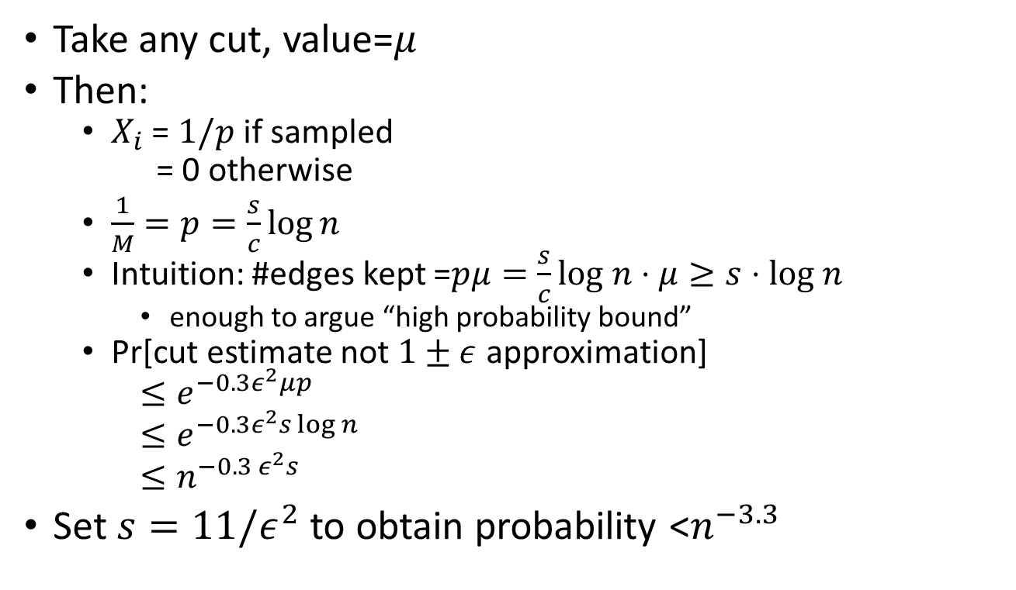

Applying Chernoff bound
Chernoff bound:
given r.v. $X_{1},X_{2},…X_{k}∈[0,M]$
expectation $𝔼\left[∑X_{i}\right]=μ$
then
$\operatorname{Pr}\left[∑X_{i}∉(1±ε)μ\right]≤e^{−{0.3ε}^{2}μ/M}$
Take any cut, value=$μ$
Then:
  $X_{i}$ = $1/p$ if sampled
  = 0 otherwise
  $\frac{1}{M}=p=\frac{s}{c}\log{n}$
  Intuition: #edges kept =$pμ=\frac{s}{c}log n⋅μ≥s⋅log n$
    enough to argue “high probability bound”
  Pr[cut estimate not $1±ε$ approximation]
  $≤e^{−0.3ε^{2}μp}$
  $≤e^{−0.3ε^{2}s log n}$
  $≤n^{−0.3 ε^{2}s}$
Set $s=11/ε^{2}$ to obtain probability <$n^{−3.3}$
since $μ≥c$

Slide 11
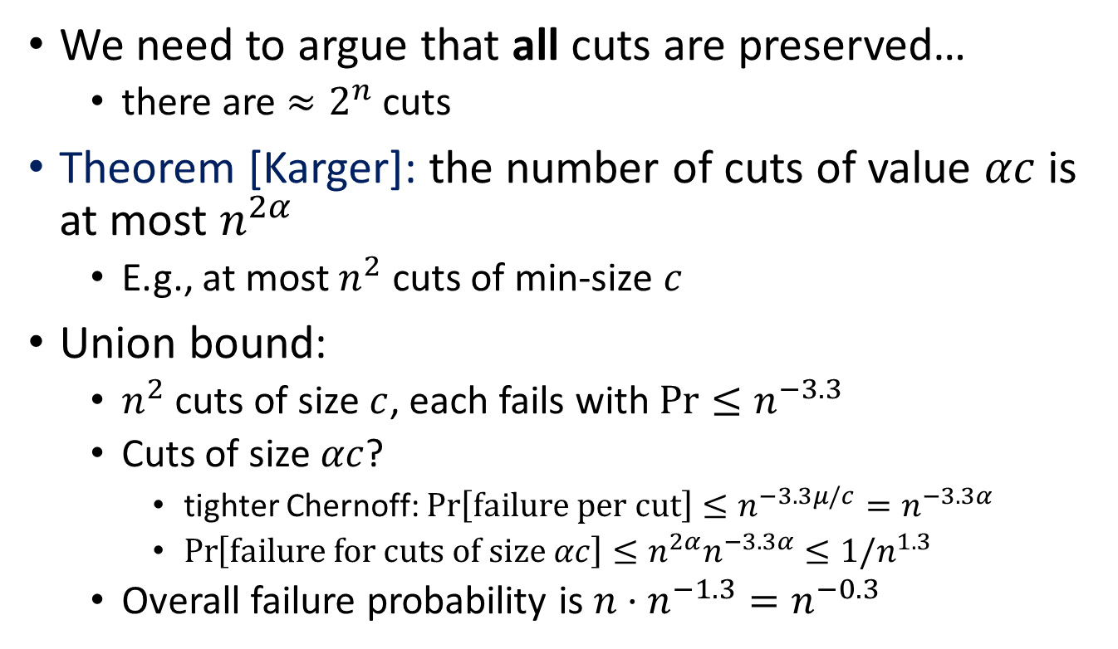
Enough?
We need to argue that all cuts are preserved…
  there are $≈2^{n}$ cuts
Theorem [Karger]: the number of cuts of value $αc$ is at most $n^{2α}$
  E.g., at most $n^{2}$ cuts of min-size $c$
Union bound:
  $n^{2}$ cuts of size $c$, each fails with $Pr⁡≤n^{−3.3}$
  Cuts of size $αc$?
    tighter Chernoff: $\operatorname{Pr}\left[failure per cut\right]≤n^{−3.3μ/c}=n^{−3.3α}$
    $\operatorname{Pr}\left[failure for cuts of size αc\right]≤n^{2α}n^{−3.3α}≤1/n^{1.3}$
  Overall failure probability is $n⋅n^{−1.3}=n^{−0.3}$

Slide 12

Smaller size?
$p=\frac{s}{c}\log{n}$, where $s=10/ε^{2}$
Useless if min-cut $c$ is small…
Sample different edges with different probabilities!

Slide 13
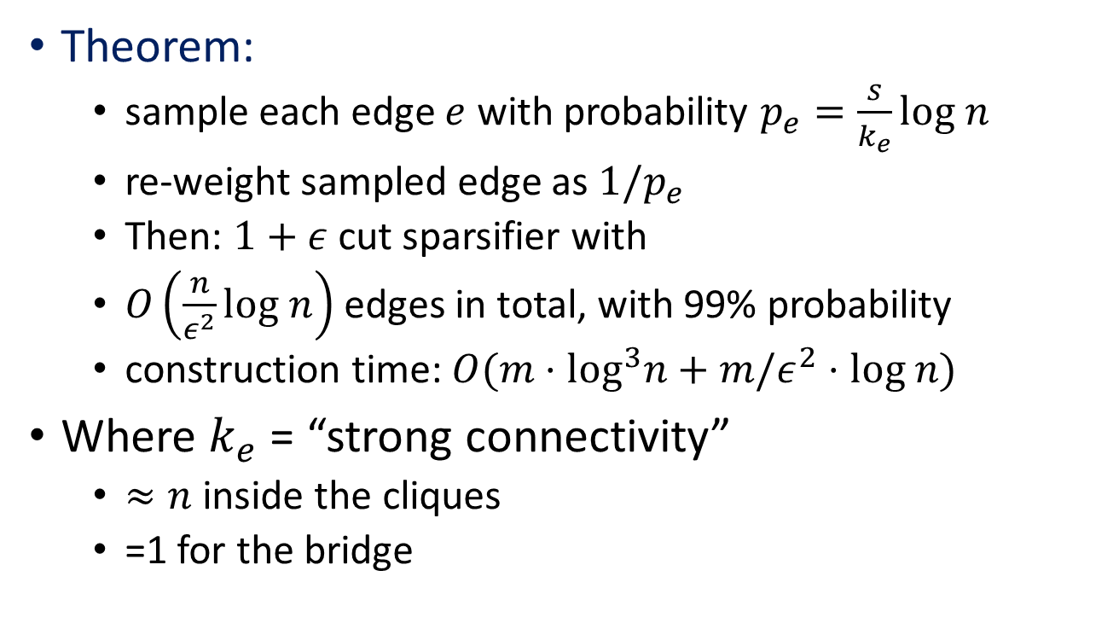
Non-uniform sampling
[Benczur-Karger’96]
Theorem:
  sample each edge $e$ with probability $p_{e}=\frac{s}{k_{e}}log n$
  re-weight sampled edge as $1/p_{e}$
  Then: $1+ε$ cut sparsifier with
  $O\left(\frac{n}{ε^{2}}log n\right)$ edges in total, with 99% probability
  construction time: $O(m⋅\log^{3}n+m/ε^{2}⋅log n)$
Where $k_{e}$ = “strong connectivity”
  $≈n$ inside the cliques
  =1 for the bridge

Slide 14


Strong connectivity
Connectivity of edge $e=(s,t)$: min-cut separating $s,t$
$k$-strongly connected component: min-cut is $k$
Strong connectivity of $e$: highest $k$ such that $e$ in $k$-strong component
Unique partitioning into $k$-strong components
Connectivity: 5
Strong conn.: 2
$$e$$

Slide 15
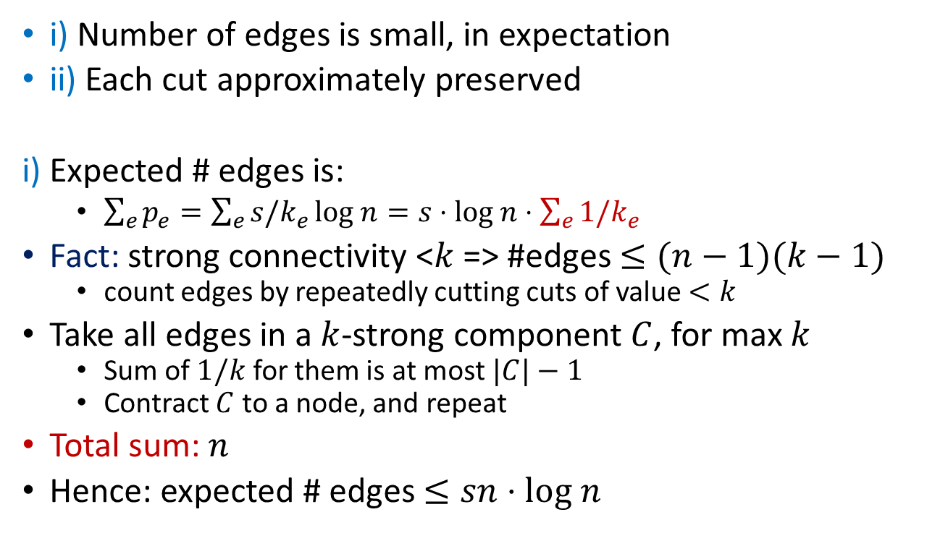
Proof of theorem
i) Number of edges is small, in expectation
ii) Each cut approximately preserved
i) Expected # edges is:
  $\sum_{e}{p_{e}}=\sum_{e}{s/k_{e}}log n=s⋅log n⋅\sum_{e}{1/k_{e}}$
Fact: strong connectivity <$k$ => #edges $≤(n−1)(k−1)$
  count edges by repeatedly cutting cuts of value $<k$
Take all edges in a $k$-strong component $C$, for max $k$
  Sum of $1/k$ for them is at most $|C|−1$
  Contract $C$ to a node, and repeat
Total sum: $n$
Hence: expected # edges $≤sn⋅log n$

Slide 16




ii) Cut values are approximated
Iteratively apply the “uniform sampling” argument
Partition edges by approx. strong-connectivity:
  $E_{i}$ are edges with strong-conn in $[2^{i}…2^{i+1})$
Sampling: as if
  first sample edges $E_{0}$, keeping rest intact (Pr sample =1)
  then sample $E_{1}$
  …
$$E_{0}$$
$$E_{1}$$
$$E_{1}$$

Slide 17

Iterative sampling
In iteration $i$:
  focus on cuts in $E_{i},E_{i+1}…$
  min-cut $≥2^{i}$
  OK to sample with $p≥\frac{s}{2^{i}}log n$
  for $s=10/{ε′}^{2}$=> error $1+ε′$
Total error ${\left(1+ε′\right)}^{\log{n}}$
  =$1+O(ε′ log n)$
Use $ε^{′}=ε/\log{n}$
Total size:
  $s\log{n}⋅n=O\left(\frac{n⋅\log^{3}n}{ε^{2}}\right)$
More attentive counting:
  $O\left(\frac{n\log{n}}{ε^{2}}\right)$

Slide 18
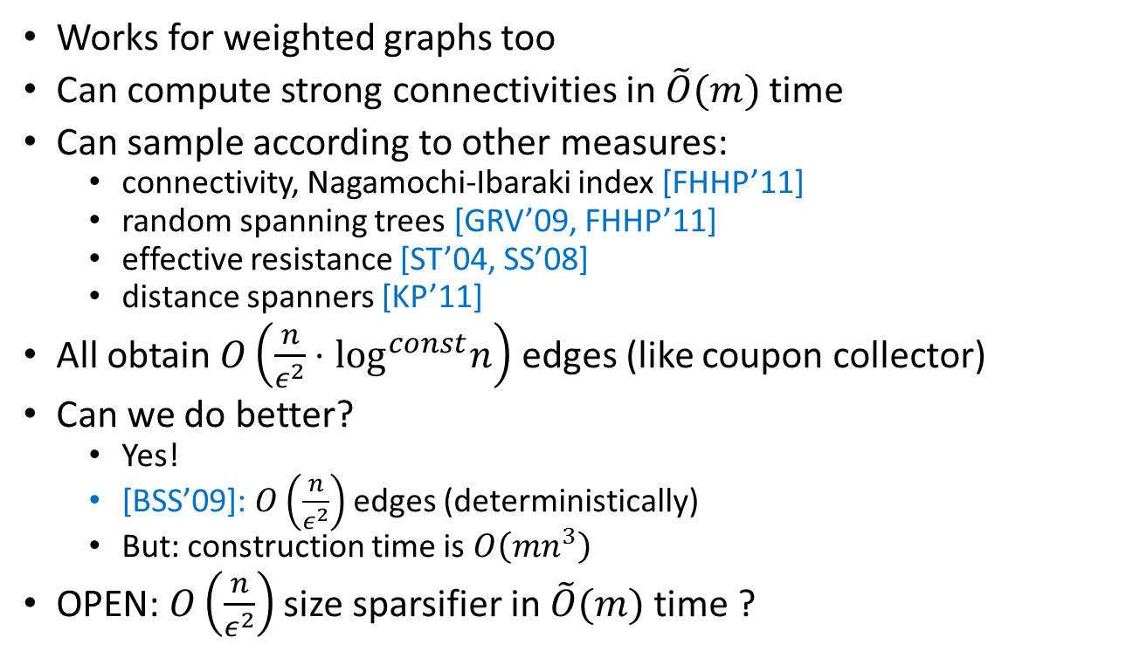
Comments
Works for weighted graphs too
Can compute strong connectivities in $\tilde{O}(m)$ time
Can sample according to other measures:
  connectivity, Nagamochi-Ibaraki index [FHHP’11]
  random spanning trees [GRV’09, FHHP’11]
  effective resistance [ST’04, SS’08]
  distance spanners [KP’11]
All obtain $O\left(\frac{n}{ε^{2}}⋅\log^{const}n\right)$ edges (like coupon collector)
Can we do better?
  Yes!
  [BSS’09]: $O\left(\frac{n}{ε^{2}}\right)$ edges (deterministically)
  But: construction time is $O\left({mn}^{3}\right)$
OPEN: $O\left(\frac{n}{ε^{2}}\right)$ size sparsifier in $\tilde{O}(m)$ time ?

Slide 19
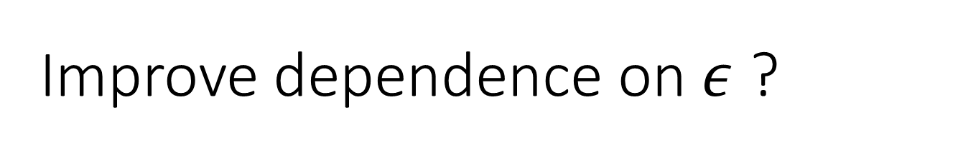
BREAK
Improve dependence on $ε$ ?

Slide 20
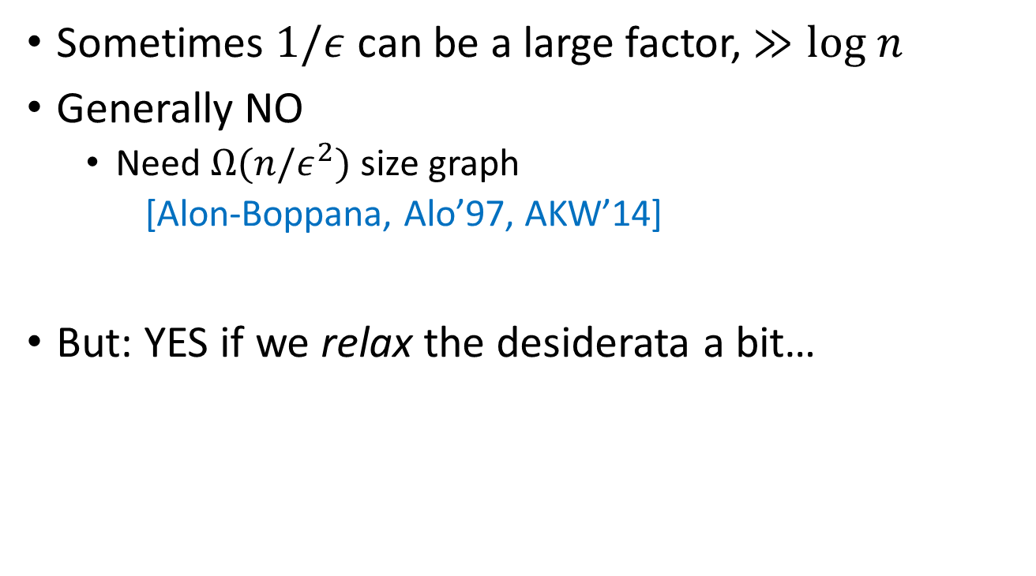
Improve dependence on $ε$ ?
Sometimes $1/ε$ can be a large factor, $≫log n$
Generally NO
  Need $Ω(n/ε^{2})$ size graph
  [Alon-Boppana, Alo’97, AKW’14]
But: YES if we relax the desiderata a bit…

Slide 21
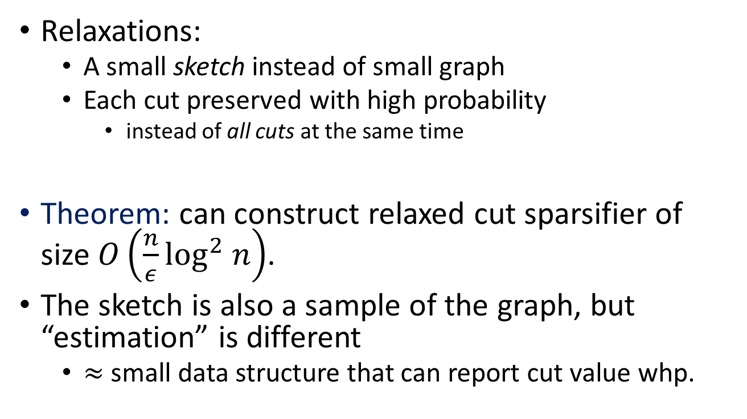
Smaller relaxed cut sparsifiers
[A-Krauthgamer-Woodruff’14]:
Relaxations:
  A small sketch instead of small graph
  Each cut preserved with high probability
    instead of all cuts at the same time
Theorem: can construct relaxed cut sparsifier of size $O\left(\frac{n}{ε}\log^{2} n\right)$.
The sketch is also a sample of the graph, but “estimation” is different
  $≈$ small data structure that can report cut value whp.

Slide 22
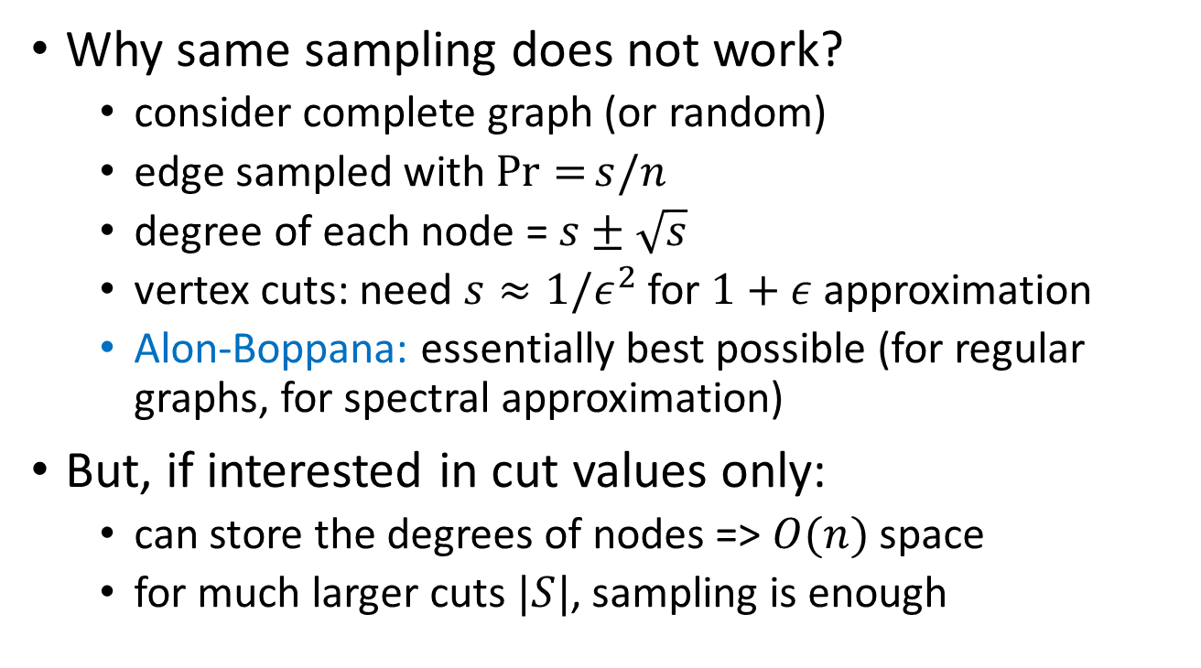
Motivating example
Why same sampling does not work?
  consider complete graph (or random)
  edge sampled with $\operatorname{Pr}{=}s/n$
  degree of each node = $s±\sqrt{s}$
  vertex cuts: need $s≈1/ε^{2}$ for $1+ε$ approximation
  Alon-Boppana: essentially best possible (for regular graphs, for spectral approximation)
But, if interested in cut values only:
  can store the degrees of nodes => $O(n)$ space
  for much larger cuts $|S|$, sampling is enough

Slide 23
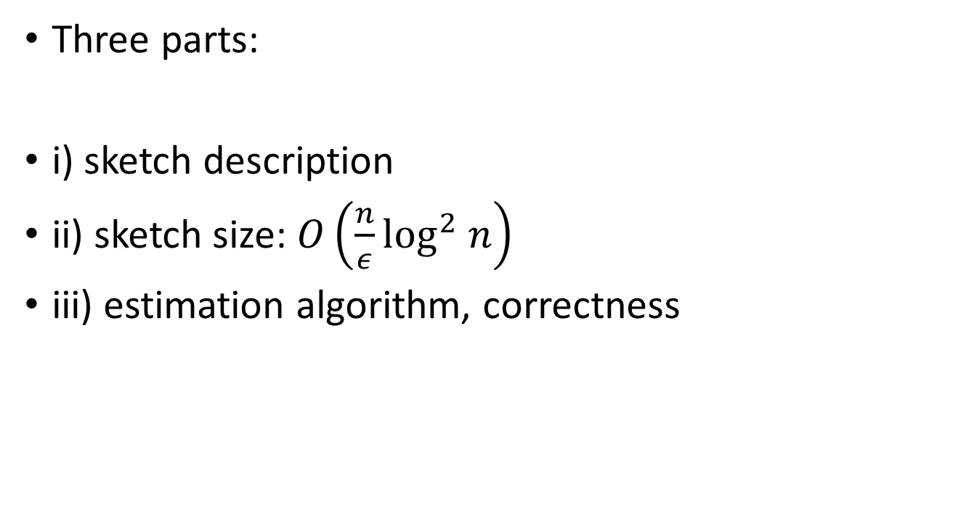
Proof of theorem
Three parts:
i) sketch description
ii) sketch size: $O\left(\frac{n}{ε}\log^{2} n\right)$
iii) estimation algorithm, correctness

Slide 24
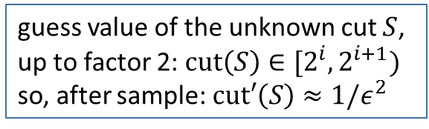
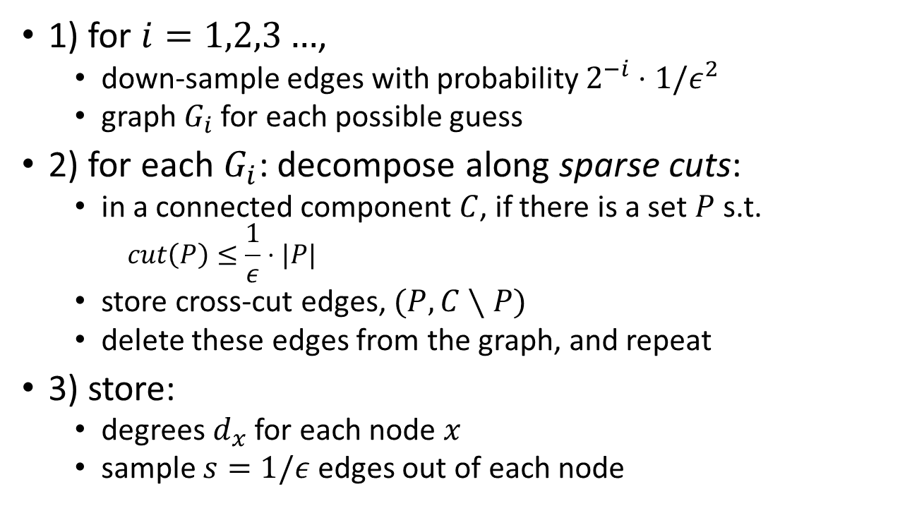
i) Sketch description
guess value of the unknown cut $S$,
up to factor 2: $cut\left(S\right)∈[2^{i},2^{i+1})$
so, after sample: $cut′\left(S\right)≈1/ε^{2}$
1) for $i=1,2,3…$,
  down-sample edges with probability $2^{−i}⋅1/ε^{2}$
  graph $G_{i}$ for each possible guess
2) for each $G_{i}$: decompose along sparse cuts:
  in a connected component $C$, if there is a set $P$ s.t.
    $$cut\left(P\right)≤\frac{1}{ε}⋅|P|$$
  store cross-cut edges, $(P,C∖P)$
  delete these edges from the graph, and repeat
3) store:
  degrees $d_{x}$ for each node $x$
  sample $s=1/ε$ edges out of each node

Slide 25

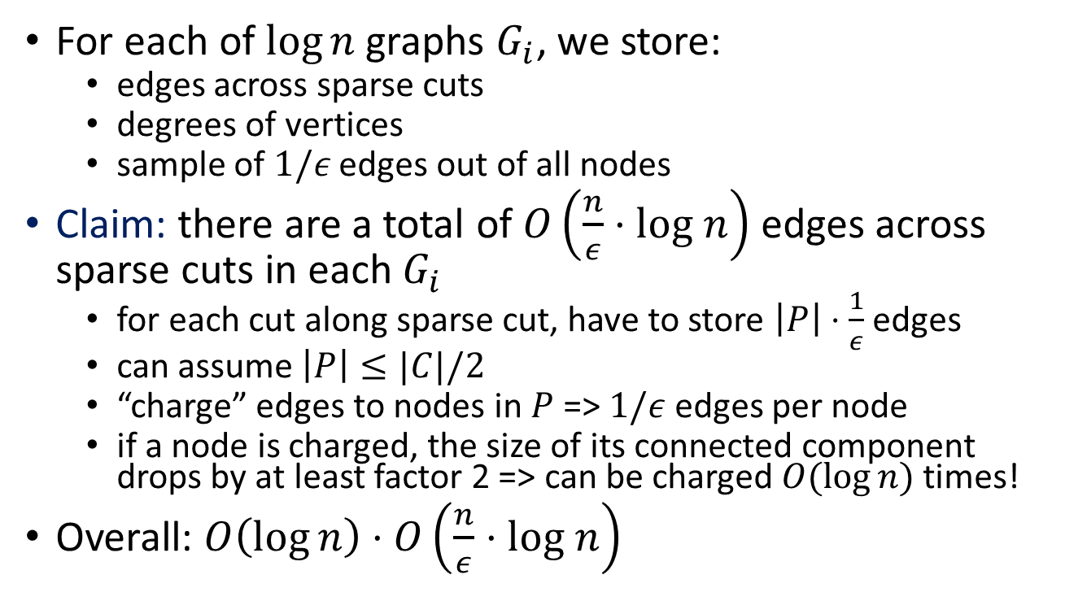
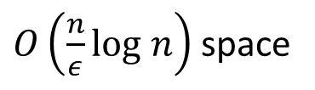

ii) Sketch size
$O\left(\frac{n}{ε}log n\right)$ space
For each of $\log{n}$ graphs $G_{i}$, we store:
  edges across sparse cuts
  degrees of vertices
  sample of $1/ε$ edges out of all nodes
Claim: there are a total of $O\left(\frac{n}{ε}⋅log n\right)$ edges across sparse cuts in each $G_{i}$
  for each cut along sparse cut, have to store $\left|P\right|⋅\frac{1}{ε}$ edges
  can assume $\left|P\right|≤|C|/2$
  “charge” edges to nodes in $P$ => $1/ε$ edges per node
  if a node is charged, the size of its connected component drops by at least factor 2 => can be charged $O(log⁡n)$ times!
Overall: $O\left(\log{n}\right)⋅O\left(\frac{n}{ε}⋅log n\right)$
???
$O(n)$ space
$O(n/ε)$ space

Slide 26
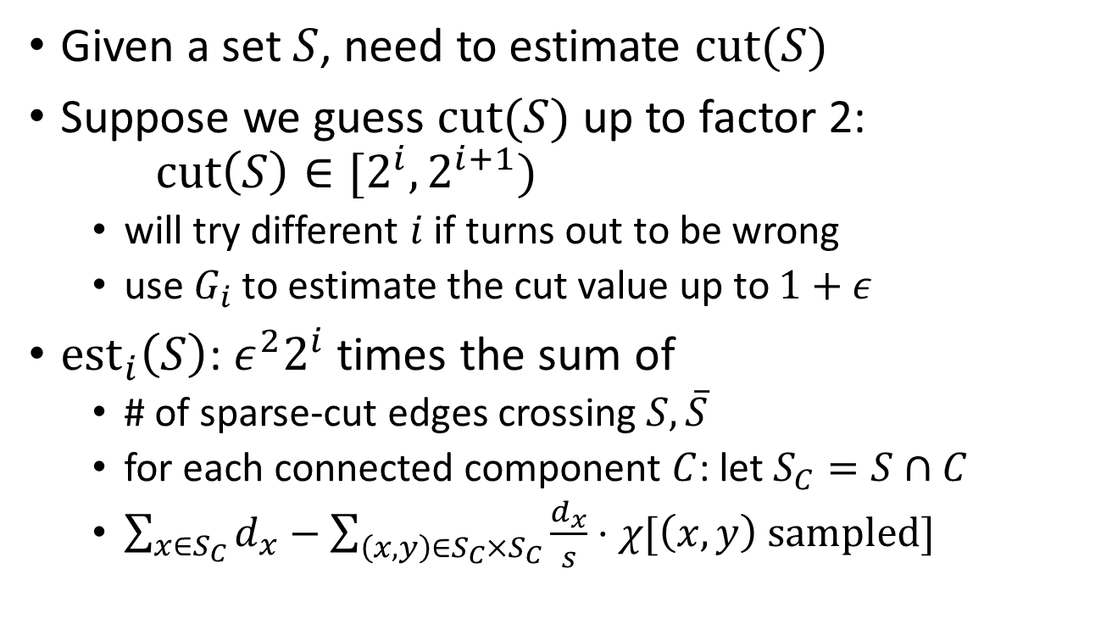
iii) Estimation
Given a set $S$, need to estimate $cut(S)$
Suppose we guess $cut(S)$ up to factor 2: $cut\left(S\right)∈[2^{i},2^{i+1})$
  will try different $i$ if turns out to be wrong
  use $G_{i}$ to estimate the cut value up to $1+ε$
${est}_{i}\left(S\right)$: $ε^{2}2^{i}$ times the sum of
  # of sparse-cut edges crossing $S, \overline{S}$
  for each connected component $C$: let $S_{C}=S∩C$
  $\sum_{x∈S_{C}}{d_{x}}−\sum_{\left(x,y\right)∈S_{C}×S_{C}}{\frac{d_{x}}{s}}⋅χ[\left(x,y\right) sampled]$

Slide 27

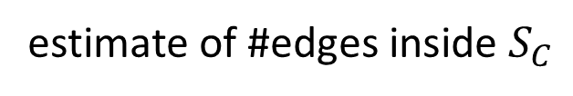

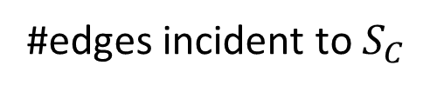


Estimation illustration
#edges incident to $S_{C}$
${est}_{i}\left(S\right)$: $ε^{2}2^{i}$ times the sum of
  # sparse-cut edges crossing $S, \overline{S}$
  for each connected $C$: let $S_{C}=S∩C$
  $\sum_{x∈S_{C}}{d_{x}}−\sum_{\left(x,y\right)∈S_{C}×S_{C}}{\frac{d_{x}}{s}}⋅χ[\left(x,y\right) sampled]$
estimate of #edges inside $S_{C}$
$$S$$
$$S_{C}$$
$$C$$
dense components

Slide 28
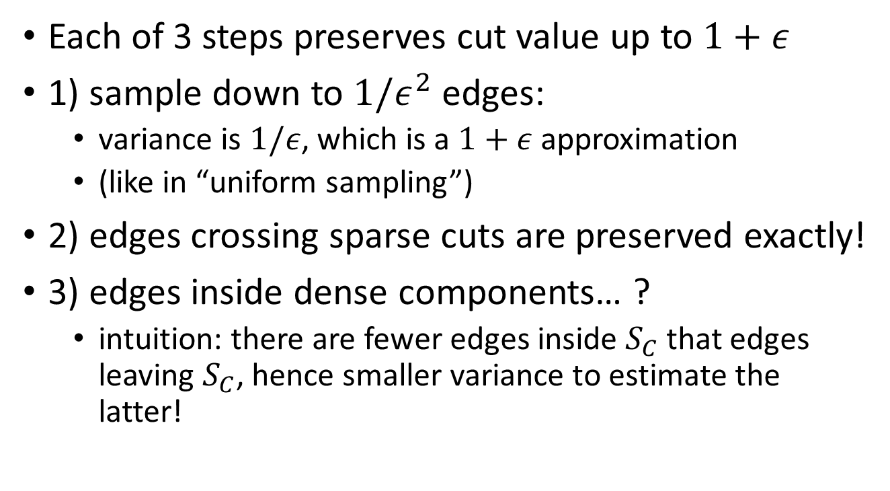
iii) Correctness of estimation
Each of 3 steps preserves cut value up to $1+ε$
1) sample down to $1/ε^{2}$ edges:
  variance is $1/ε$, which is a $1+ε$ approximation
  (like in “uniform sampling”)
2) edges crossing sparse cuts are preserved exactly!
3) edges inside dense components… ?
  intuition: there are fewer edges inside $S_{C}$ that edges leaving $S_{C}$, hence smaller variance to estimate the latter!

Slide 29
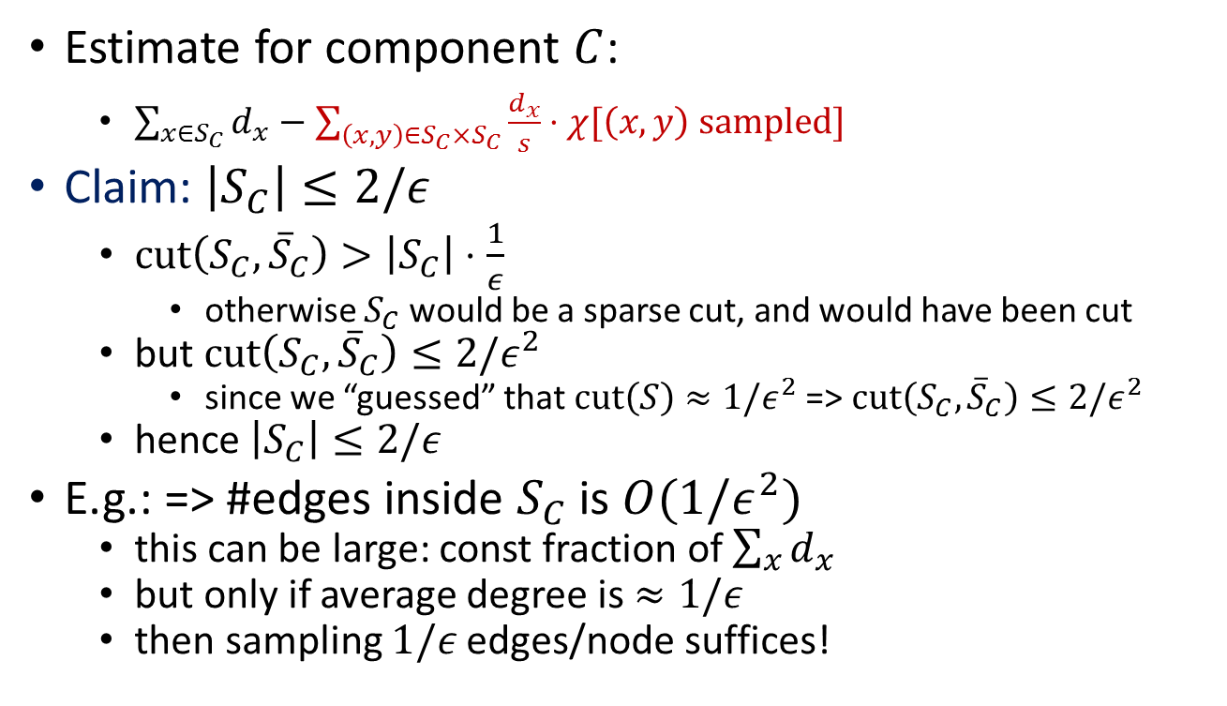
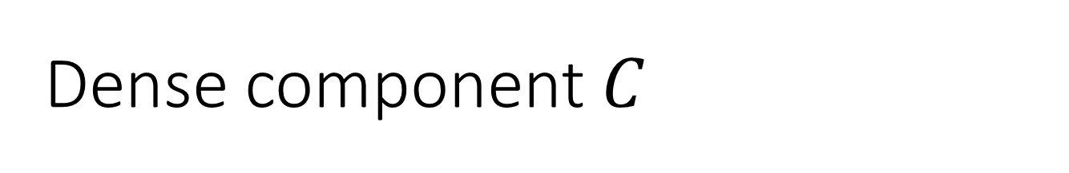


Dense component $C$
$$S_{C}$$
$${\overline{S}}_{C}$$
Estimate for component $C$:
    $\sum_{x∈S_{C}}{d_{x}}−\sum_{\left(x,y\right)∈S_{C}×S_{C}}{\frac{d_{x}}{s}}⋅χ[\left(x,y\right) sampled]$
Claim: $\left|S_{C}\right|≤2/ε$
  $cut\left(S_{C},{\overline{S}}_{C}\right)>\left|S_{C}\right|⋅\frac{1}{ε}$
    otherwise $S_{C}$ would be a sparse cut, and would have been cut
  but $cut\left(S_{C}, {\overline{S}}_{C}\right)≤2/ε^{2}$
    since we “guessed” that $cut\left(S\right)≈1/ε^{2}$ => $cut\left(S_{C}, {\overline{S}}_{C}\right)≤2/ε^{2}$
  hence $\left|S_{C}\right|≤2/ε$
E.g.: => #edges inside $S_{C}$ is $O({1/ε}^{2})$
  this can be large: const fraction of $\sum_{x}{d_{x}}$
  but only if average degree is $≈1/ε$
  then sampling $1/ε$ edges/node suffices!

Slide 30
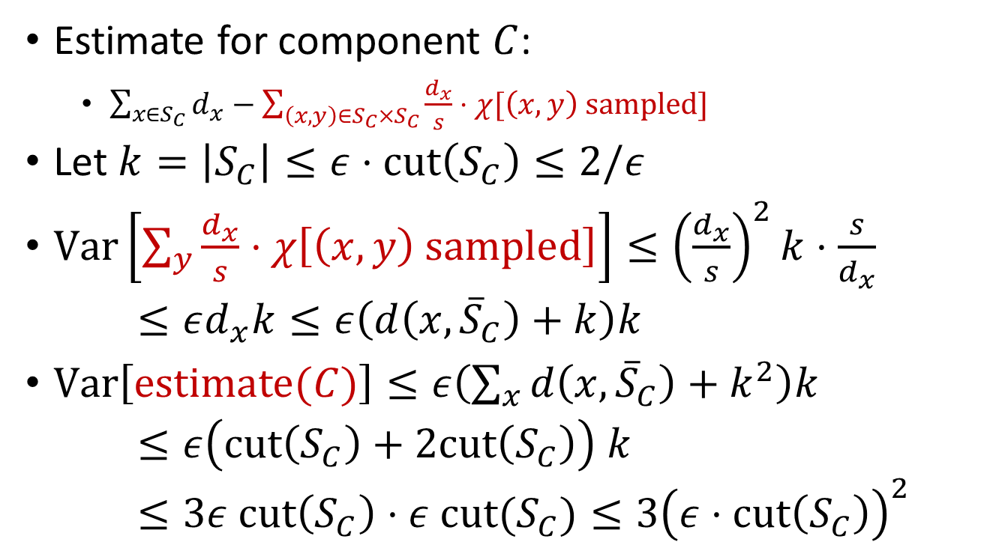

Variance
$$S_{C}$$
$${\overline{S}}_{C}$$
Estimate for component $C$:
    $\sum_{x∈S_{C}}{d_{x}}−\sum_{\left(x,y\right)∈S_{C}×S_{C}}{\frac{d_{x}}{s}}⋅χ[\left(x,y\right) sampled]$
Let $k=\left|S_{C}\right|≤ε⋅cut\left(S_{C}\right)≤2/ε$
$Var\left[\sum_{y}{\frac{d_{x}}{s}⋅χ\left[\left(x,y\right) sampled\right]}\right]≤{\left(\frac{d_{x}}{s}\right)}^{2}k⋅\frac{s}{d_{x}}$
$≤εd_{x}k≤ε\left(d\left(x,{\overline{S}}_{C}\right)+k\right)k$
$Var\left[estimate(C)\right]≤ε\left(\sum_{x}{d\left(x,{\overline{S}}_{C}\right)}+k^{2}\right)k$
$≤ε\left(cut\left(S_{C}\right)+2cut\left(S_{C}\right)\right) k$
$≤3ε cut\left(S_{C}\right)⋅ε cut(S_{C})≤3{\left(ε⋅cut\left(S_{C}\right)\right)}^{2}$
$$s=1/ε$$

Slide 31
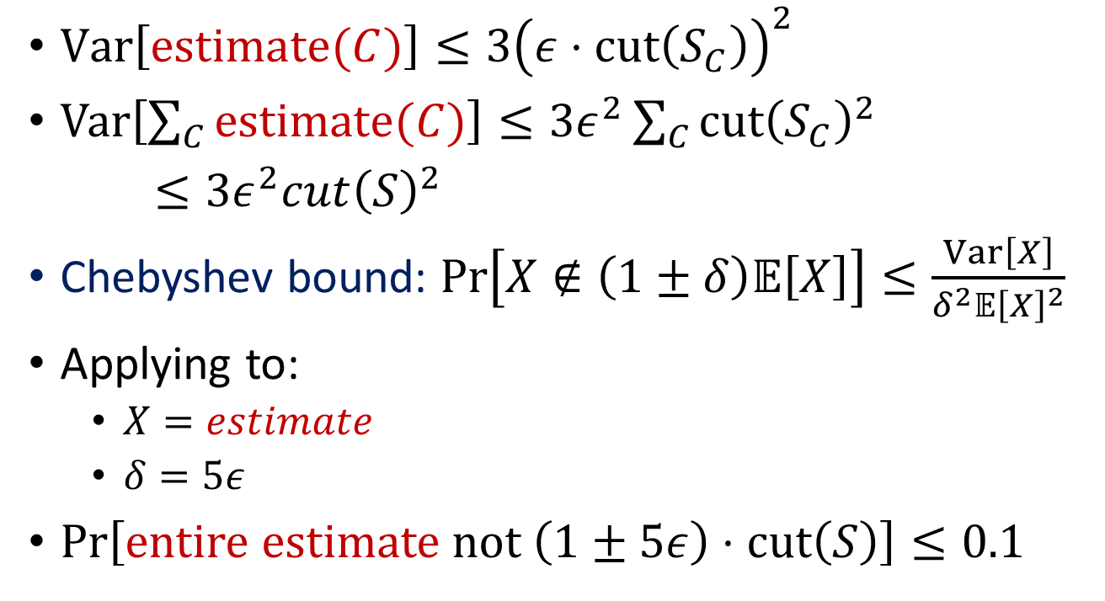
Dense component estimate
$Var\left[estimate(C)\right]≤3{\left(ε⋅cut\left(S_{C}\right)\right)}^{2}$
$Var\left[\sum_{C}{estimate(C)}\right]≤3ε^{2}\sum_{C}{cut{\left(S_{C}\right)}^{2}}$
$≤3ε^{2}cut{\left(S\right)}^{2}$
Chebyshev bound: $\operatorname{Pr}\left[X∉\left(1±δ\right)𝔼\left[X\right]\right]≤\frac{Var\left[X\right]}{δ^{2}𝔼{\left[X\right]}^{2}}$
Applying to:
  $X=estimate$
  $δ=5ε$
$\operatorname{Pr}\left[entire estimate not \left(1±5ε\right)⋅cut\left(S\right)\right]≤0.1$

Slide 32
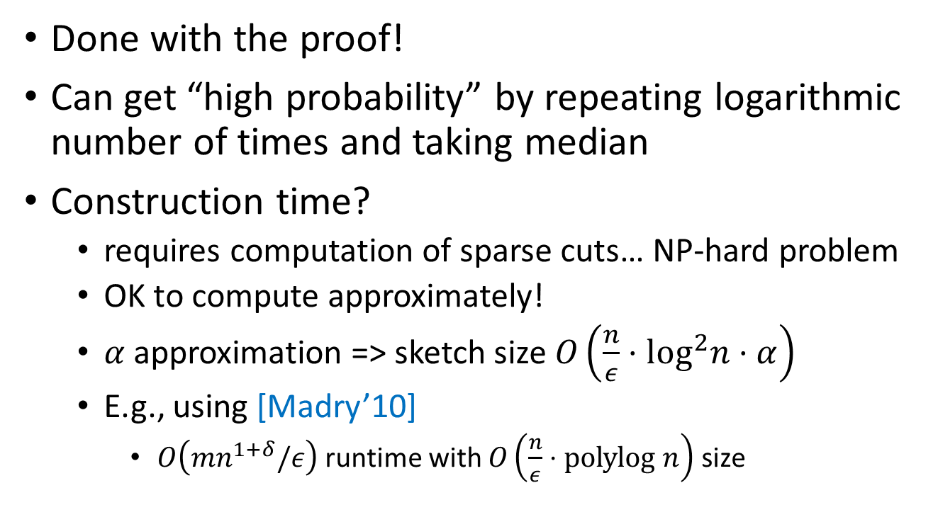
Concluding remarks
$$S_{C}$$
Done with the proof!
Can get “high probability” by repeating logarithmic number of times and taking median
Construction time?
  requires computation of sparse cuts… NP-hard problem
  OK to compute approximately!
  $α$ approximation => sketch size $O\left(\frac{n}{ε}⋅\log^{2}n⋅α\right)$
  E.g., using [Madry’10]
    $O\left(mn^{1+δ}/ε\right)$ runtime with $O\left(\frac{n}{ε}⋅polylog n\right)$ size

Slide 33
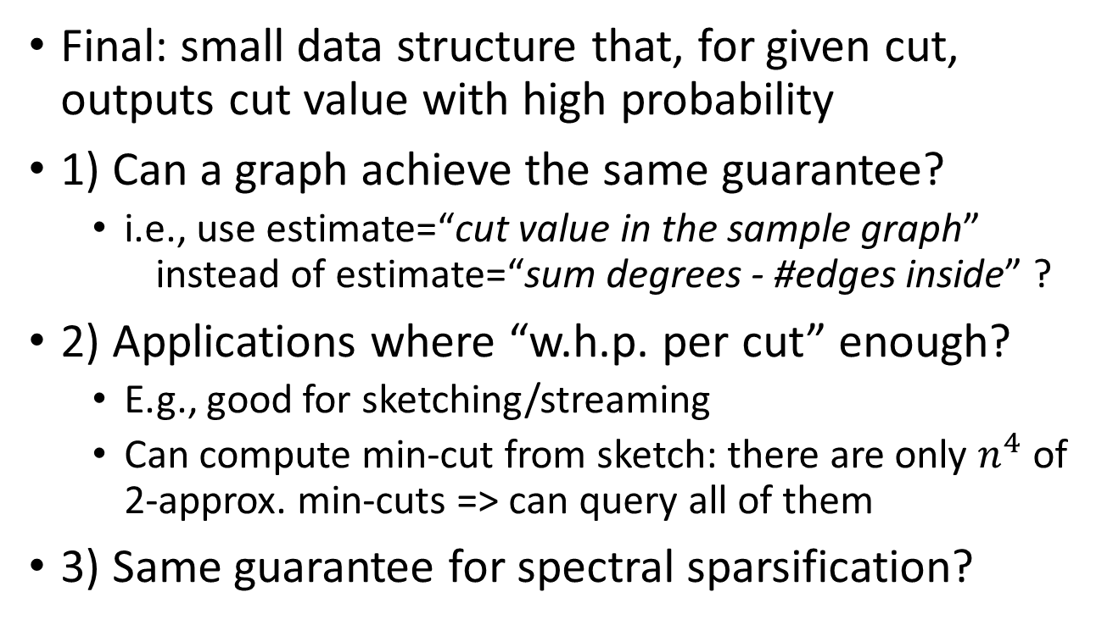
Open questions
Final: small data structure that, for given cut, outputs cut value with high probability
1) Can a graph achieve the same guarantee?
  i.e., use estimate=“cut value in the sample graph” instead of estimate=“sum degrees - #edges inside” ?
2) Applications where “w.h.p. per cut” enough?
  E.g., good for sketching/streaming
  Can compute min-cut from sketch: there are only $n^{4}$ of 2-approx. min-cuts => can query all of them
3) Same guarantee for spectral sparsification?

