Slide 1
Sketching and Nearest Neighbor Search (2)
Alex Andoni
(Columbia University)

Slide 2
Sketching
$S:ℜ^{d}$ $→$ short bit-strings
given $S(x)$ and $S(y)$, should be able to estimate some function of $x$ and $y$
$ℓ_{2}$, $ℓ_{1}$ norm: $O(ε^{−2})$ words
Decision version: given $r$ in advance…
$ℓ_{2}$, $ℓ_{1}$ norm: $O(ε^{−2})$ bits
$$x$$
$$y$$
$$S$$
$$S$$
010110
010101
Estimate $||x−y||_{2}$
Distinguish between
$$||x−y||≤r$$
$$||x−y||>\left(1+ε\right)r$$

Slide 3
Sketching: decision version
Consider Hamming space: $x,y∈{\left\{0,1\right\}}^{d}$
Lemma: for any $r$, can achieve $O(1/ε^{2})$ bit sketch.

Slide 4
Nearest Neighbor Search (NNS)
Preprocess: a set $D$ of points
Query: given a query point $q$, report a point $p∈D$ with the smallest distance to $q$
$$p$$
$$q$$

Slide 5
Motivation
Generic setup:
Points model objects (e.g. images)
Distance models (dis)similarity measure
Application areas:
machine learning: k-NN rule
image/video/music recognition, deduplication, bioinformatics, etc…
Distance can be:
Hamming, Euclidean, …
Primitive for other problems:
find the similar pairs, clustering…
000000
011100
010100
000100
010100
011111
000000
001100
000100
000100
110100
111111
$$p$$
$$q$$

Slide 6
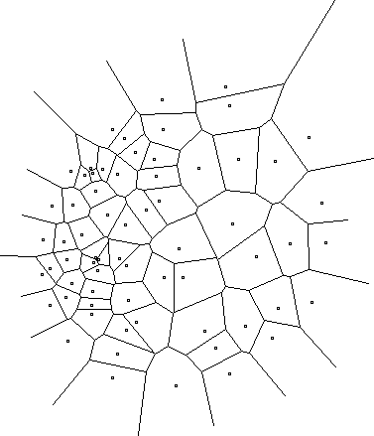
Curse of Dimensionality
All exact algorithms degrade rapidly with the dimension $d$
Algorithm | Query time | Space
Voronoi diagram | $${\left(d⋅\log{n}\right)}^{O\left(1\right)}$$ | $n^{O(d)}$
Linear scan | $$O(n⋅d)$$ | $$O(n⋅d)$$

Slide 7
Approximate NNS
$c$-approximate
$r$-near neighbor: given a query point $q$, report a point $p^{′}∈P$ s.t. $\left\|p′−q\right\|≤r$
assuming there is a point within distance $r$
Practice: use for exact NNS
Filtering: gives a set of candidates (hopefully small)
$$cr$$
$$r$$
$$p^{∗}$$
$$cr$$
$$q$$
$$p^{′}$$

Slide 8
NNS algorithms
Dependence on dimension:
Exponential
[Arya-Mount’93], [Clarkson’94], [Arya-Mount-Netanyahu-Silverman-We’98], [Kleinberg’97], [Har-Peled’02],[Arya-Fonseca-Mount’11],…
Linear/polynomial
[Kushilevitz-Ostrovsky-Rabani’98], [Indyk-Motwani’98], [Indyk’98, ‘01], [Gionis-Indyk-Motwani’99], [Charikar’02], [Datar-Immorlica-Indyk-Mirrokni’04], [Chakrabarti-Regev’04], [Panigrahy’06], [Ailon-Chazelle’06], [A.-Indyk’06], [A.-Indyk-Nguyen-Razenshteyn’14], [A.-Razenshteyn’15]

Slide 9
NNS via sketching: Approach 1
Boosted sketch:
Let $S$ = sketch for the decision version (90% success prob)
new sketch $W$ : $k=O(\log{n})$ copies of $S$
estimator is the median of the $k$ estimators
Sketch size: $O(ε^{−2}\log{n})$
Success probability: $1−n^{−2}$
Preprocess: compute sketches $W(p)$ for all the points $p∈D$
Query: compute sketch $W(q)$, and compute distance to all points using sketch
Time: improved from $O(nd)$ to $O(nε^{−2}\log{n})$

Slide 10
NNS via sketching: Approach 2
Query time below $n$ ?
Theorem [KOR98]: $O(dε^{−2}log n)$ query time and $n^{O\left(1/ε^{2}\right)}$ space for $1+ε$ approximation.
Proof:
Note that $W(q)$ has $w=O\left(ε^{−2}\log{n}\right)$ bits
Only $2^{w}$ possible sketches!
Store an answer for each of $2^{w}=n^{O\left(ε^{−2}\right)}$ possible inputs
If a distance has constant-size sketch, admits a poly-space NNS data structure!
Space closer to linear?
approach 3 will require more specialized sketches…

Slide 11
3: Locality Sensitive Hashing
[Indyk-Motwani’98]
$$q$$
$$p′$$
Random hash function $h$ on $R^{d}$
satisfying:
for close pair (when $\left\|q−p\right\|≤r$)
$Pr⁡[h(q)=h(p)]$ is “high”
for far pair (when $\left\|q−p′\right\|>cr$)
$Pr⁡[h(q)=h(p′)]$ is “small”
Use several hash tables
$$p$$
$$q$$
$$P1=$$
“not-so-small”
$$P2=$$
$$Pr⁡[h(q)=h(p)]$$
$$ρ=\frac{\log{1/P_{1}}}{\log{1/P_{2}}}$$
1
$nρ$, where
$$P1$$
$$P2$$
$$\left\|q−p\right\|$$
$$r$$
$$cr$$

Slide 12
Locality sensitive hash functions
Hash function $g$ is usually a concatenation of “primitive” functions:
$g\left(p\right)=\left\langle h_{1}(p),h_{2}(p),…,h_{k}(p)\right\rangle$
Example: Hamming space ${\left\{0,1\right\}}^{d}$
$h\left(p\right)=p_{j}$ , i.e., choose $j^{th}$ bit for a random $j$
$g(p)$ chooses $k$ bits at random
$\operatorname{Pr}\left[h\left(p\right)=h\left(q\right)\right]= 1 –\frac{Ham\left(p,q\right)}{d}$
$P_{1}=1−\frac{r}{d}≈e^{−r/d}$
$P_{2}=1−\frac{cr}{d}≈e^{−cr/d}$
$ρ=\frac{\log{1/P_{1}}}{\log{1/P_{2}}}=\frac{r/d}{cr/d}=\frac{1}{c}$

Slide 13
Full algorithm
Data structure is just $L=n^{ρ}$ hash tables:
Each hash table uses a fresh random function $g_{i}\left(p\right)=\left\langle h_{i,1}(p),…,h_{i,k}(p)\right\rangle$
Hash all dataset points into the table
Query:
Check for collisions in each of the hash tables
until we encounter a point within distance $cr$
Guarantees:
Space: $O\left(nL\right)=O(n^{1+ρ})$, plus space to store points
Query time: $O\left(L⋅(k+d)\right)=O(n^{ρ}⋅d)$ (in expectation)
50% probability of success.
Notes:
Draw L hash tables

Slide 14
Analysis of LSH Scheme
Choice of parameters $k,L$ ?
$L$ hash tables with $g\left(p\right)=\left\langle h_{1}(p),…,h_{k}(p)\right\rangle$
Pr[collision of far pair] = $P_{2}^{k}$
Pr[collision of close pair] = $P_{1}^{k}$
Hence $L=O(n^{ρ})$ “repetitions” (tables) suffice!
set $k$ s.t.
= $1/n$
= ${\left(P_{2}^{ρ}\right)}^{k}={1/n}^{ρ}$
$$P_{1}$$
$$P_{1}^{2}$$
$$P_{2}$$
$$k=1$$
$$P_{2}^{2}$$
$$k=2$$
$$r$$
$$cr$$

Slide 15
Analysis: Correctness
Let $p^{∗}$ be an $r$-near neighbor
If does not exists, algorithm can output anything
Algorithm fails when:
near neighbor $p^{∗}$ is not in the searched buckets $g_{1}\left(q\right), g_{2}\left(q\right), …,g_{L}\left(q\right)$
Probability of failure:
Probability $q,p^{∗}$ do not collide in a hash table: $≤1−P_{1}^{k}$
Probability they do not collide in $L$ hash tables at most
$${\left(1−P_{1}^{k}\right)}^{L}={\left(1−\frac{1}{n^{ρ}}\right)}^{n^{ρ}}≤1/e$$

Slide 16
Analysis: Runtime
Runtime dominated by:
Hash function evaluation: $O(L⋅k)$ time
Distance computations to points in buckets
Distance computations:
Care only about far points, at distance $>cR$
In one hash table, we have
Probability a far point collides is at most $P_{2}^{k}=1/n$
Expected number of far points in a bucket: $n⋅\frac{1}{n}=1$
Over $L$ hash tables, expected number of far points is $L$
Total: $O\left(Lk\right)+O\left(Ld\right)=O(n^{ρ}\left(\log{n}+d\right))$ in expectation

Slide 17
NNS for Euclidean space
[Datar-Immorlica-Indyk-Mirrokni’04]
Hash function $g$ is a concatenation of “primitive” functions:
$g\left(p\right)=\left\langle h_{1}(p),h_{2}(p),…,h_{k}(p)\right\rangle$
LSH function $h(p)$:
pick a random line $ℓ$, and quantize
project point into $ℓ$
$h\left(p\right)=\left\lfloor \frac{p⋅ℓ}{w}+b\right\rfloor$
$ℓ$ is a random Gaussian vector
$b$ random in $[0,1]$
$w$ is a parameter (e.g., 4)
$ρ=1/c$
$$ℓ$$
$$p$$

Slide 18
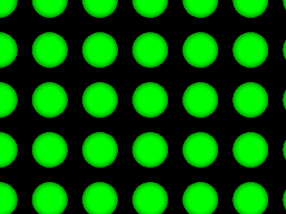
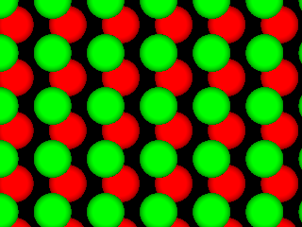
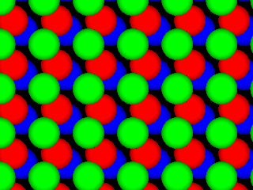
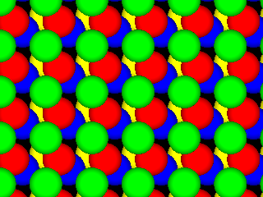
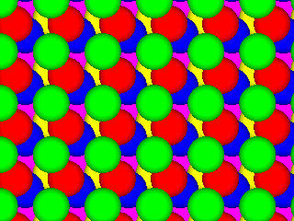
Optimal Euclidean LSH
[A-Indyk’06]
Regular grid → grid of balls
p can hit empty space, so take more such grids until p is in a ball
Need (too) many grids of balls
Start by projecting in dimension t
Analysis gives
Choice of reduced dimension t?
Tradeoff between
# hash tables, n^{ρ}, and
Time to hash, t^{O(t)}
Total query time: dn^{1/c2+o(1)}
p
2D
p
R^{t}

Slide 19
Proof idea
p
Claim: , i.e.,
P(r)=probability of collision when ||p-q||=r
Intuitive proof:
Projection approx preserves distances [JL]
P(r) = intersection / union
P(r)≈random point u beyond the dashed line
Fact (high dimensions): the x-coordinate of u has a nearly Gaussian distribution
→ P(r) ≈ exp(-A·r²)
r
q
p
q
P(r)
x
$P\left(r\right)=\exp\left(−Ar^{2}\right)={\left[exp⁡(−A{(cr)}^{2}\right]}^{1/c^{2}}={P(cr)}^{1/c^{2}}$
u

Slide 20
Open question:
More practical variant of above hashing?
Design space partitioning of $ℜ^{t}$ that is
efficient: point location in poly(t) time
qualitative: regions are “sphere-like”
$$p$$
c²
[Prob. needle of length 1 is not cut]
≥
[Prob needle of length c is not cut]

Slide 21
LSH Zoo
To be or not to be
To sketch or not to sketch
Hamming distance [IM’98]
$h$: pick a random coordinate(s)
Manhattan distance [AI’06]
$h$: cell in a randomly shifted grid
Jaccard distance between sets:
$J\left(A,B\right)=\frac{A∩B}{A∪B}$
$h$: pick a random permutation $π$ on the universe
$h\left(A\right)=\min_{a∈A} π(a)$
min-wise hashing [Bro’97]
…
sketch
sketch
not
not
not
not
be
or
to
be
or
to
1
…01111…
…11101…
1
…21102…
…01122…
{be,not,or,to}
{not,or,to,
sketch}
be
to
$π$=be,to,sketch,or,not

Slide 22
LSH in practice
$$k$$
safety not
guaranteed
fewer false
positives
If want exact NNS, what is $c$?
Can choose any parameters $L,k$
Correct as long as ${\left(1−P_{1}^{k}\right)}^{L}≤0.1$
Performance:
trade-off between # tables and false positives
will depend on dataset “quality”
fewer tables
$$L$$

